Slide 1

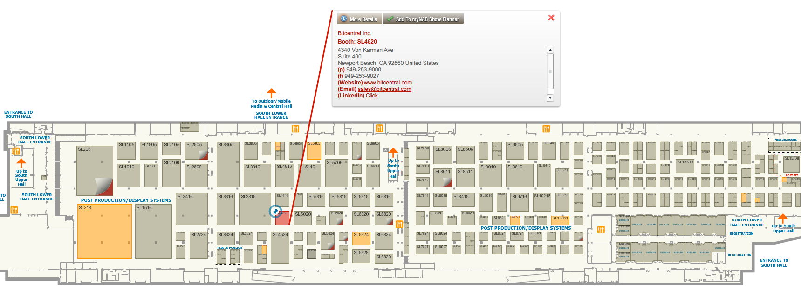
www.bitcentral.com
Ask about the product "Create"

Slide 2

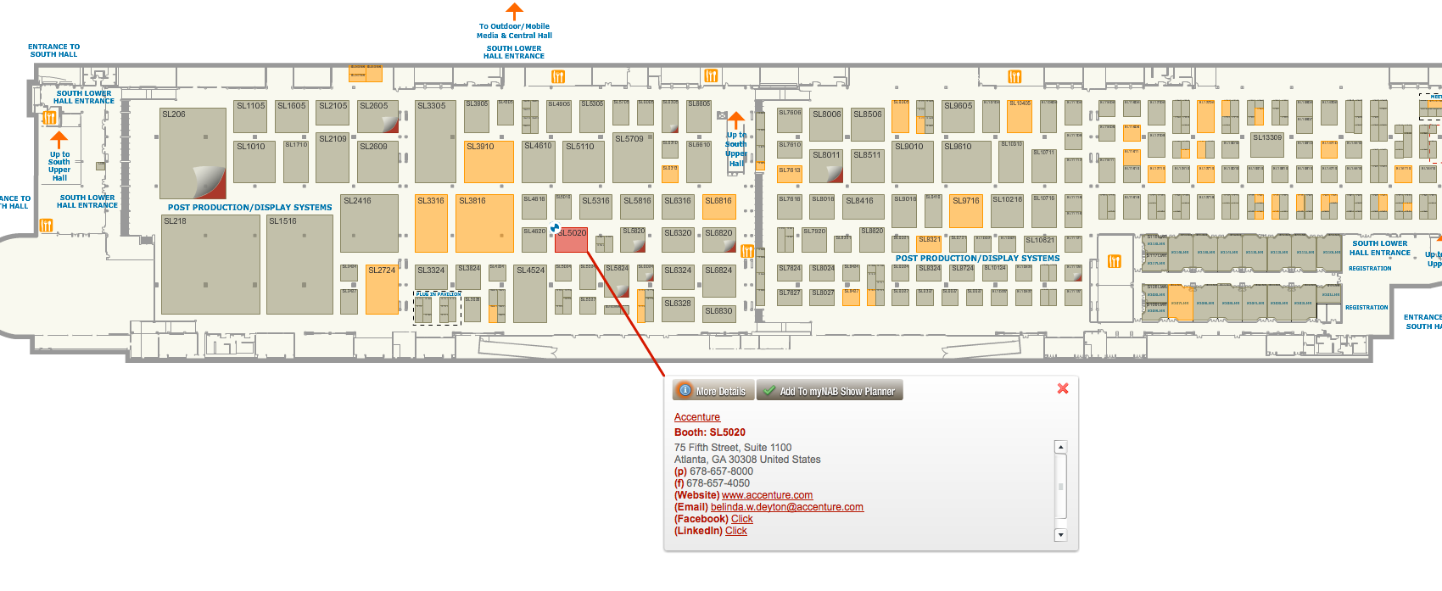
www.accenture.com
Ask “So Whats New in Crowd Sourcing?”

Slide 3

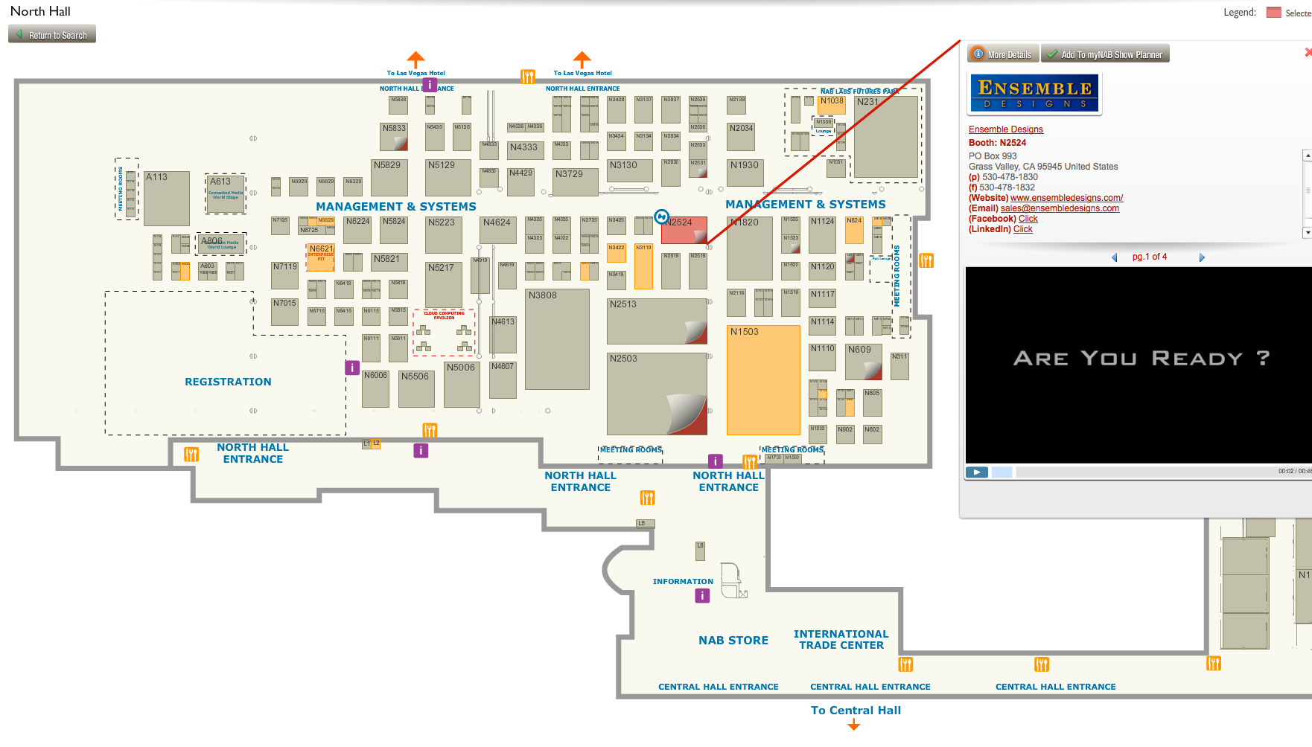
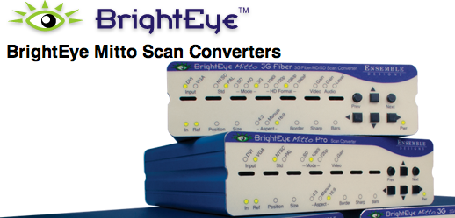
http://www.ensembledesigns.com
Ask about products.: BrightEye Scan Converters. This is what KENS uses to display pixelbling to the Air.

Slide 4

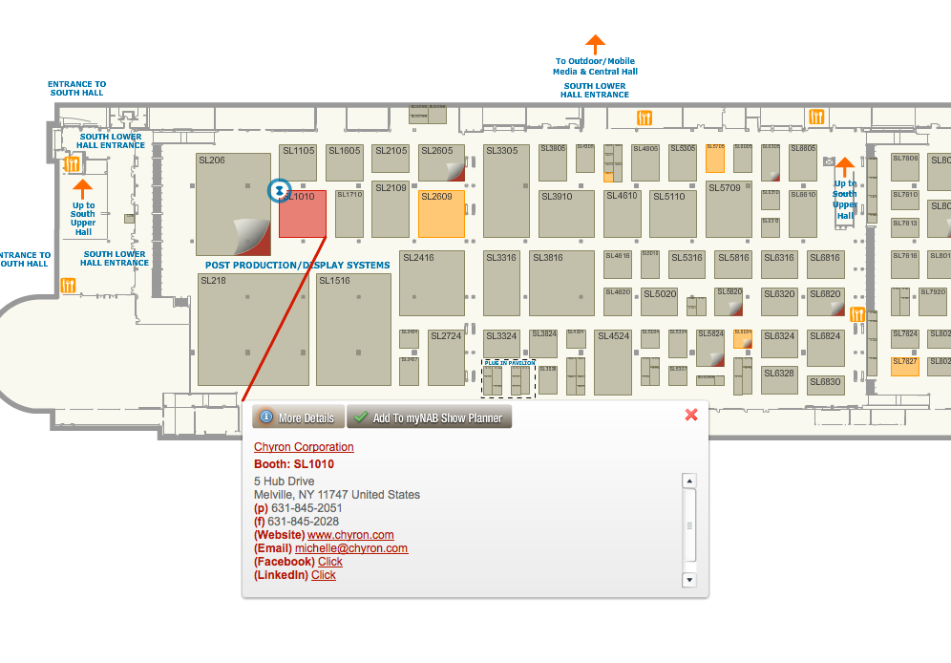
http://www.chyron.com
Ask about products.: Shout, and Axis Graphics

Slide 5




I did not see them on the NAB map. However please Look for these companies just in case.
www.filemobile.com
www.secondstreet.com
www.olapic.com
www.mobilelocalnews.com
PRODUCT: Media Factory: Monthly FEES: Widgets: $1500 per month
PRODUCT: myCapture: myCapture Community is typically $450/month for your market.
PRODUCT: Publishers: He said 17k -25 k range. Lets say 20k per year. That is about about $1660 per month
PRODUCT: DOAPP: Cost unkown. I think this is a Phone APP.

