Slide 1
1) Able to play Video that is sent in by a phone Template. No Transitions. No Moving Bkgs
REPLY: This is correct. No Transitions. No Moving Bkgs. Video/Template. Ability to trim video Play and Pause with space bar.
2) When you say, sent in by a phone, I assume you mean that Customers will upload videos as the one slide for these type of albums. Were you thinking that they would send them in as an email, the same way images are sent in by email? I think this would be a problem because most email providers don’t allow you to send files bigger than 10 MB as an attachment, and I would think that most videos are bigger than 10 MB. Please advise on this.
REPLY: Viewers will send through e-mail a video they recorded on their mobile device. The same way they send images. Not sure about the size restrictions, However Cell Journalist does it all the time. Viewers are sending phone videos more frequently. I am not sure how Cell Journalist is doing it…?
3) I think we would need a new type of album, or perhaps a new hard-coded theme or theme(s) that only allows one slide, and expects it to be a video. Also, the background for this theme would always be a static image. We could make it so that both advanced and basic users get this customer theme, or just advanced if you want. We would also have to change the image library a little bit to allow it to know that there are 2 types of items – images and videos. We can discuss the details later, I just want to make sure we’re going in the right direction.
REPLY: A new hard coded theme/Template would be OK. YES, The background would be static. I think both Service Plans would have it. But yes we are going in the right direction.
4) Image/ Template that displays an image Full Screen with a lower third banner that exist on top. No Transitions. No Moving Bkgs REPLY: This is correct. I ATTACHED an Example of what the look is for this template.
TWO NEW QUOTES FOR TEMPLATES / 1. Expanded Image Fullscreen with Lwr3rd overlay 2. Video Play (Ability to trim video Play and Pause with space bar).
Examples Below

Slide 2
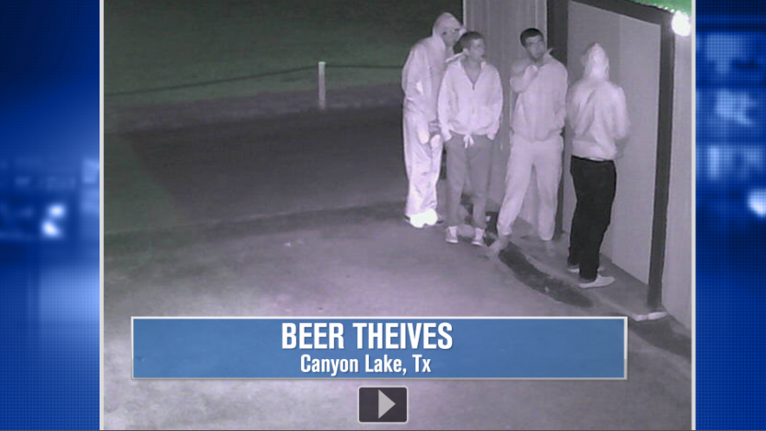
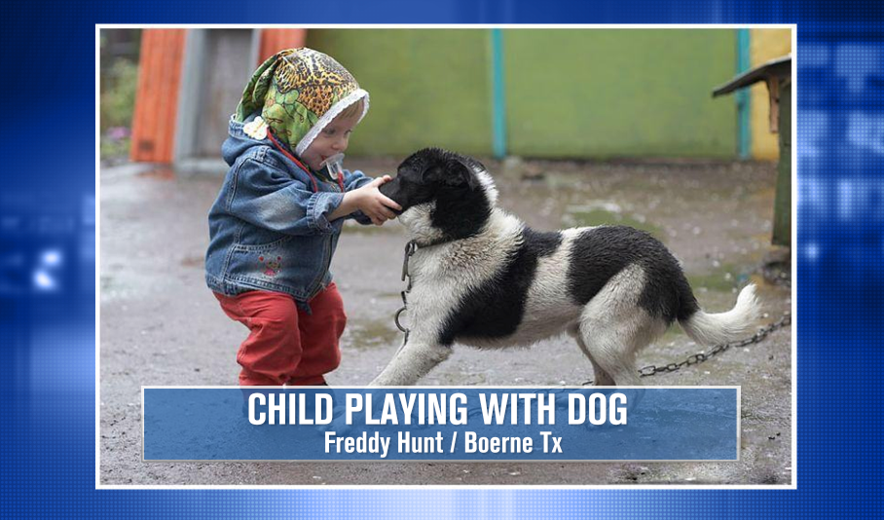
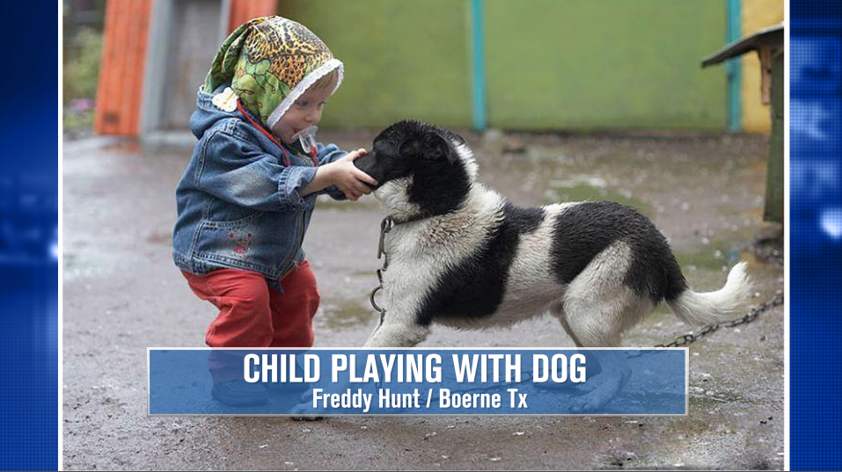
New Templates Continued
Video / Template. Ability to trim video Play and Pause with space bar.
Expanded Image Full Screen with Lwr3rd overlay
OR

Slide 3
VND Questions
1. Can Albums/Pixelbling be integrated or viewed within another website? (i.e. kens5.com <http://kens5.com> )
2. Dedicated server: Is it redundant? Where is the server physically? What happens when San Antonio has a blackout?
3. What is the cost to translate into Spanish?

