Slide 1

Pixel Bling Notes
Hello Victor, we have completed all the points from the meeting with a couple of notes on some those points. I have included my comments in the notes below. These were the final notes to complete the project. Please take a look at the notes that have comments in them and respond to them. Also, we still need access to the dedicated server that you are going to use. Here is what we need:
FTP Info Ability to create Database Remote My SQL Access C Panel access if you have it SSH access if they allow you to have it
Ask for theme when user creates an album, make the dropdown a requirement --Done,
  NOTE: When creating an Album can there be a thumbnail associated with the template? Maybe this could be an option on the Admin side where Admin assigns a thumbnail to the theme. NOTE: When creating an Album, make dropdown a requirement for transition also ---OR--- Can you have it assign the Cube transition as the default for any Album created?
Don't allow user to change theme on the Dashboard page-- Done NOTE: Perfect!
Superadmin - Edit Customer, make the next payment date editable--Done NOTE: Perfect!
Delete all the test data except for: Linda fleming Anything with victor Anything with pixelbling Alex account --Done NOTE: Perfect!
Add active - true or false for customer themes--Done NOTE: Perfect! a) Add validation that active cannot be unchecked if an album is already usingthat customer theme--Done NOTE: Done

Slide 2
Superadmin - Customer Themes - remove "delete" and "add new”
  --Done NOTE: NOT Seeing this?
Remove the "brown video theme" (victor calls it the orange theme), from thesite, including the default themes—Done
  NOTE: Done
Remove the "view application" from the customers datalist
  —Done NOTE: Done
Put a note on Edit Customer Theme - always use 940 x 560, always upload .ogvfiles
  --Done NOTE: Perfect!
Send email templates to victor so he can see how they will look, on every partof the site that sends emails
  --Done NOTE: Done --Done, I do have the email templates, I forwarded them to you in separate emails

Slide 3
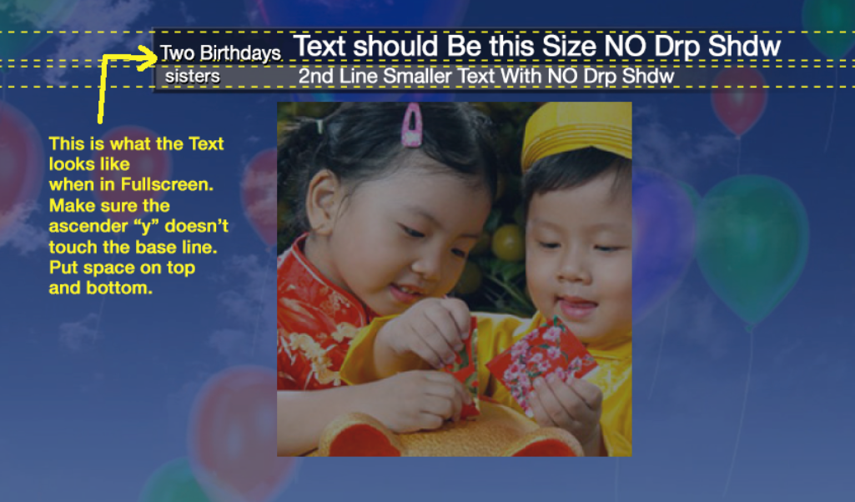
11) The fullscreen for the birthdays, the title, desc positioning is a little off
  ------ NOTE: - Text Placement Needs a little more adjusting.

Slide 4
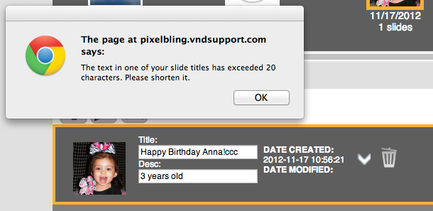
Make the title 2 px's bigger than the description
  --Done
13) Limit title/desc to 40 chars except if its twitter/facebook
    I Get this message about Exceeded 20 Characters. It Should say 40 Characters

Slide 5
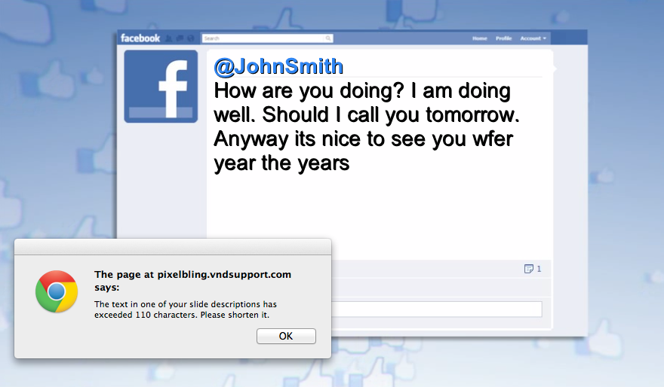
We need to have a separate max width for fullscreen than for preview
  NOTE: For the Face Book FullScreen, Can we get a Max Limit of 180-200 Characters? Font may have to go down a point size.

Slide 6
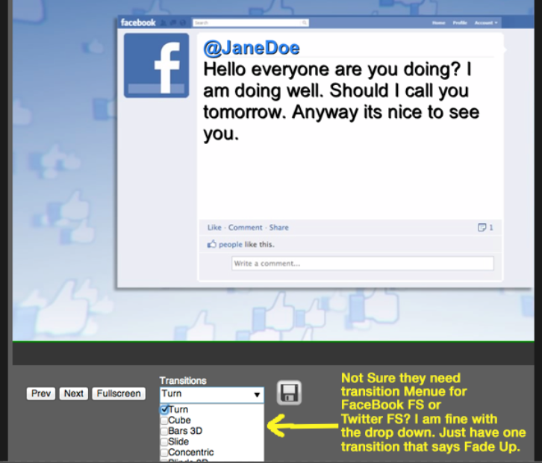
  NOTE: For the Face Book FullScreen, Not Sure they need transition Menu for FaceBook FS or Twitter FS? I am fine with the drop down. Just have one transition that says Fade Up.

Slide 7
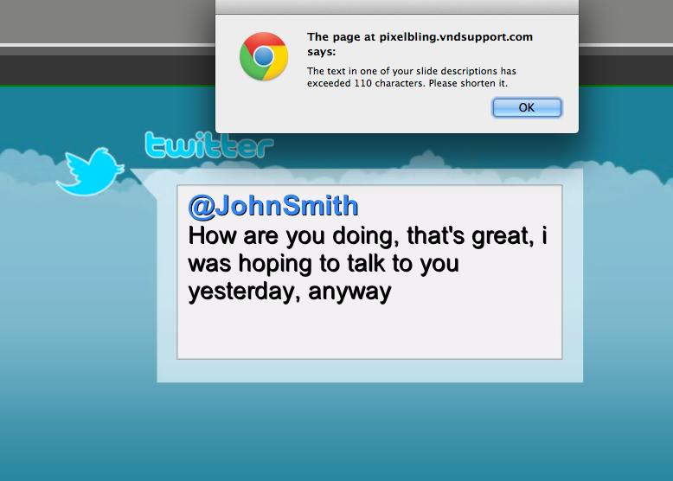
Make sure the face book and twitter are wrapping at the correct place, and change the max chars for the way that face book and twitter needs to have it
  --DoneNOTE: For the TWITTER FullScreen, Can we get a Max Limit of 200 Characters? Info below.
  There used to be a time on Twitter when tweets were limited to 140 characters. Not any more. Most of the character counters you see when posting tweets are no longer valid. Why? In a word, T.CO.Because Twitter now applies its t.co url shortener to EVERY string of text that looks like a domain, every domain is counted as 20 characters. 19 for the t.co shortened URL, and 1 for the space. So, if you shorten your URL to 12 characters using bit.ly, for instance, AND leave out the “http://”, your URL is still counted as twenty characters.For example the following tweet (minus the quotes) is exactly 140 characters:“I am a tweet. I have exactly 140 characters. If you want to make sure that I only have 140 characters you can check for yourself. 0123456789″However, if you replace the last 20 characters with a really long URL as in the following example, and submit it at Twitter.com, the resulting 178 character string will be accepted.“I am a tweet. I have exactly 140 characters. If you want to make sure that I only have 140 characters you can check for http://www.pay4tweet.com/buy.php?this_is_a_really_long_url”In this case, Twitter internally replaces the URL with one shortened with their t.co url shortening service, but displays your URL, up to a certain point. It seems that Twitter crops long URLs after 50 or so characters, but you can still get past the once immovable 140 character limit. So, that last tweet actually has more than 140 characters, but as far as Twitter is concerned, it’s right at the limit. http://blog.pay4tweet.com/2012/04/27/twitter-lifts-140-character-limit/

Slide 8
16) If they select twitter, automatically add 5 blank slides
  --Done
For the adding of blank slides, when the album selected is Facebook orTwitter, the "open image library" plus sign icon will simply add another blank slide
  --Done
18) Facebook album cover should always be a facebook icon
  —Done
Twitter album cover should always be a twitter icon
  --Done
20) On the Albums datalist page, the num per page is 5, should be 25
  --Done
On the signup process, the checkbox for "signup for newsletter" should say"Agree to terms and conditions”
  --Done
Free Trial process should be a gateway passthrough.
  --Done

Slide 9
23) Check if we can change the way to escape out of fullscreen, by hitting escapetwice, can just change to hit escape once.
  --Done
24) Sometimes when you open the image library edit tool, it freezes. Check why this might be happening
  -I'm not sure why this is happening. It could be because the edit tool takes up alittle extra resources on whatever computer the person is browsing google chrome on.
  NOTE: Lets keep an eye on it.
Need Backup plan for Editing Tool, but first let Victor email the Editing ToolCompany - Aviary, and see if he can remove the "Get this tool”
  PHOTOcoolex Flash Image Editor is about $200-$500. If we buy this editor can we use it with our site?
  http://www.flash-image-editor.com/index,index
  --Victor, we still need you to contact this company and try to see if they will let you remove the "Get this tool" part of the editing tool
  I sent them a request. Not real sure if they will let us remove “Get this Tool” However, this is not a major concern. According to their FAQs, they say NO to the Logo removal unless we pay $2,000/month.

Slide 10
Victor wants the transitions to be faster, not the pause in between, but theactual transition part
  --Not Done, need to send to Rent-A-Coder
27) On the dropdown checkbox for the transitions, can it open upwards instead ofdownwards? Check if this is possible
  --Done, I checked into this, there is an option to make the page scroll down alittle bit in case the dropdown is at the bottom of the page. I went ahead and implemented this feature, so it should work better now. There is not an option tomake it scroll up.
On the contact us page, changesales@pixelbling.com<mailto:sales@pixelbling.com> toinfo@pixelbling.com<mailto:info@pixelbling.com>--Done
  --Done
29) Change the link title in the header, from "Get Started" to "How it works”
  --Done NOTE: I don’t see this . Still says Get Started
Add another menu item called "Min-Requirements" with the page I created,should not require login but should have a link if you are logged in or not
  --Done
Replace the | English | link at the top to | Upgrade Account |
  --Done NOTE: I don’t see this . Looks the same

Slide 11
Use the new "Service Plans" page for all the places that have that: "Services Plan" sub page Signup Upgrade Re-subscribe (Upgrade and re-subscribe are the same page)
  --Done
The title that shows in the Google Chrome tab at the top should be"PixelBling" not "Pixel Bling" (no space)
  —Done
Send email to Fabian that the slideshow is running slow now because we added different videos. Ask him if there's any way to clear the browser cache with code.—
  Raul and I are still discussing this point

Slide 12
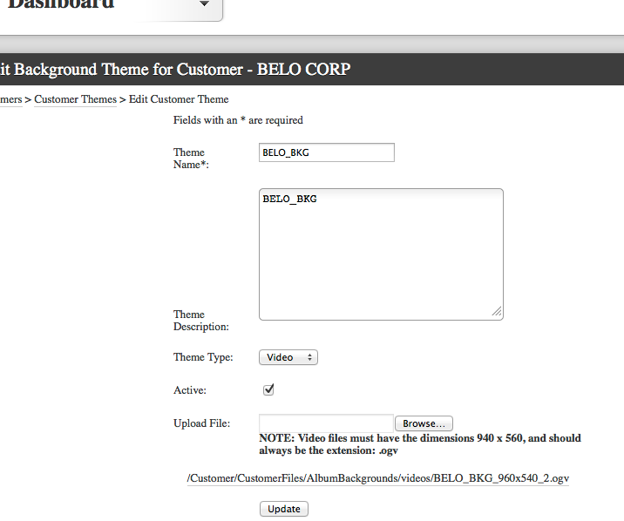
35). How do I upload a New OGV file as a BKG?

Slide 13
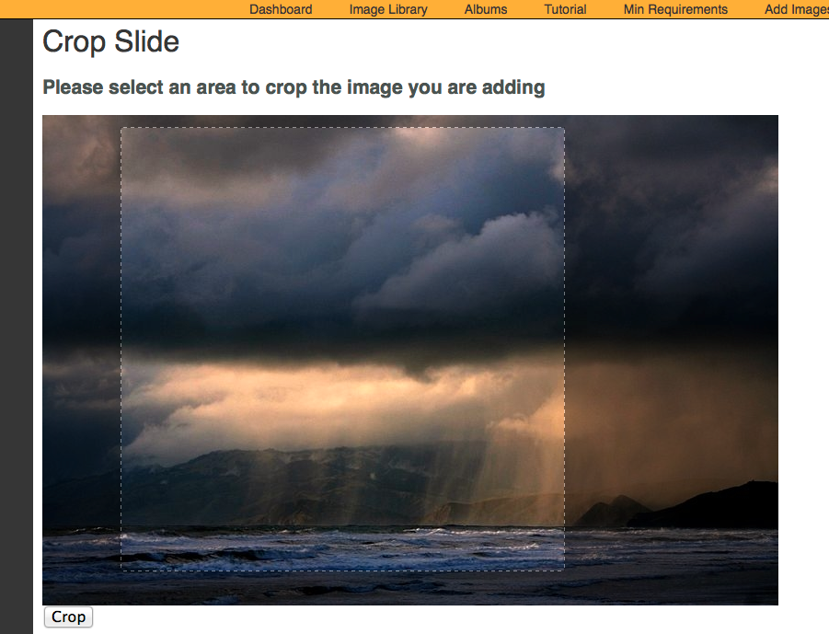
36). Need to play VIDEO
37). Need a Full Screen Template. No Moving Bkg
38). Need to revisit the crop aspect ration. Needs to proportionate scale.

Slide 14
SERVICE PLANS: Both Service Plans include the following. You’ll have the capability to receive and organize your photos, create slides, and play them from your PC onto the air.
•Pixelbling Parses photos from the email address(es) and send them to an Image Library. • Viewers submit their photos designated email address. • Image Library that sorts and organizes Photos. • Create Multiple Albums • Fullscreen photo templates with text field • Fullscreen Mode for On Air Broadcast • Upload Pics from desktop • Dynamic Transitions • Editing Tool for Images.
I. STANDARD PLAN $220/mo
This plan is a basic plan that gets your viewer pics straight to the air with ease. Viewers submit their photos to ONE designated email address.
Templates:
•FS Weather Photo w/text
•FS Generic Photo w/text
•FS Birthday Photo w/text
Transitions:
•Cube
•Slide
•Blinds 3D
II. ADVANCED PLAN $350/mo
This plan gets you everything in the Basic plan, plus the capability for much more customization.- Viewers submit their photos to 1-3 designated email address.
Templates:
• FS Weather Photo w/text
•FS Generic Photo w/text
•FS Birthday Photo w/text
•FS Celebrity Birthday w/text
•FS Headshot / Mug w/text
•FS Facebook Text Only
•FS Twitter Text Only
Transitions:
•Turn
• Cube
•Bars 3D
• Slide
• Concentric
• Blinds 3D

Slide 15
39). In ADMIN Dashboard, Would Like the option of assigning Service I or Service II, to any user that we create through admin.

