Slide 1
Pixel Bling Notes
Free Trial Gets Service TWO
Super Admin - Customer Themes – Super Admin will choose Service I or Service II
Need Backup plan for Editing Tool, Not sure what to choose or purchase? We will address at later date, but for now we will continue with aviary.
Min-Requirements" Mozilla before Google Chrome
Free Trial Gets Service TWO
Super Admin - Customer Themes – Super Admin will choose Service I or Service II
Need Backup plan for Editing Tool, Not sure what to choose or purchase? We will address at later date, but for now we will continue with aviary.
Min-Requirements" Mozilla before Google Chrome

Slide 2
The full screens, the title, desc positioning is a little off. Needs to be centered
NOTE: - Text Placement Needs a little more adjusting. Adjust Text alignment on the FULLSCREEN side.
Make Top text 48pts size

Slide 3
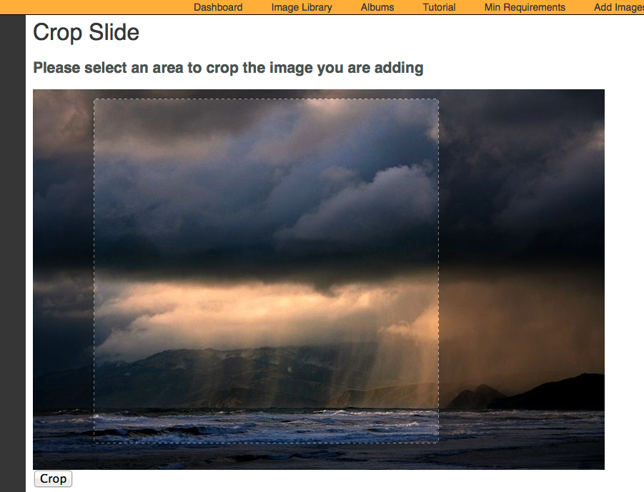
38). Need to revisit the crop aspect ration. Needs to proportionate scale.

Slide 4
SERVICE PLANS: Both Service Plans include the following. You’ll have the capability to receive and organize your photos, create slides, and play them from your PC onto the air.
•Pixelbling Parses photos from the email address(es) and send them to an Image Library. • Viewers submit their photos designated email address. • Image Library that sorts and organizes Photos. • Create Multiple Albums • Fullscreen photo templates with text field • Fullscreen Mode for On Air Broadcast • Upload Pics from desktop • Dynamic Transitions • Editing Tool for Images.
I. STANDARD PLAN $220/mo
This plan is a basic plan that gets your viewer pics straight to the air with ease. Viewers submit their photos to ONE designated email address.
Templates:
•FS Weather Photo w/text
•FS Generic Photo w/text
•FS Birthday Photo w/text
Transitions:
•Cube
•Slide
•Blinds 3D
II. ADVANCED PLAN $350/mo
This plan gets you everything in the Basic plan, plus the capability for much more customization.- Viewers submit their photos to 1-3 designated email address.
Templates:
• FS Weather Photo w/text
•FS Generic Photo w/text
•FS Birthday Photo w/text
•FS Celebrity Birthday w/text
•FS Headshot / Mug w/text
•FS Facebook Text Only
•FS Twitter Text Only
Transitions:
•Turn
• Cube
•Bars 3D
• Slide
• Concentric
• Blinds 3D

Slide 5
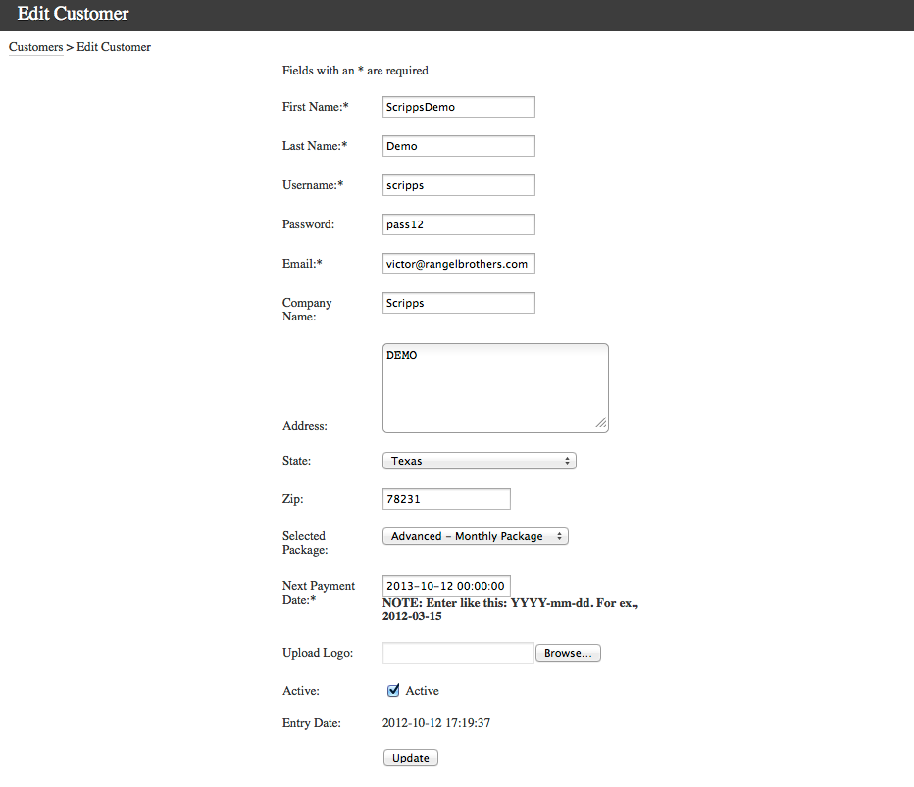
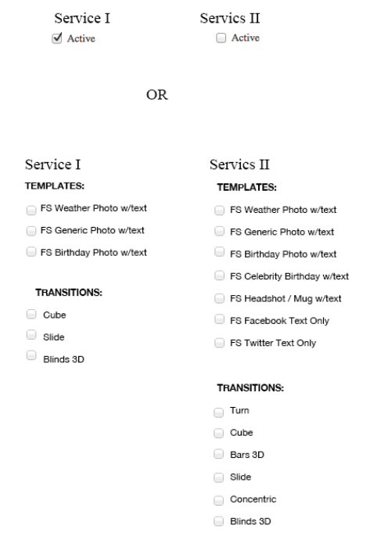
39). In ADMIN Dashboard, Would Like the option of assigning Service I or Service II, to any user that we create through admin.

Slide 7
Able to play Video that is sent in by a phone Template. No Transitions. No Moving Bkgs REPLY: This is correct. No Transitions. No Moving Bkgs. Questions: 1) When you say, sent in by a phone, I assume you mean that Customers will upload videos as the one slide for these type of albums. Were you thinking that they would send them in as an email, the same way images are sent in by email? I think this would be a problem because most email providers don’t allow you to send files bigger than 10 MB as an attachment, and I would think that most videos are bigger than 10 MB. Please advise on this. REPLY: Viewers will send through e-mail a video they recorded on their mobile device. The same way they send images. Not sure about the size restrictions, However Cell Journalist does it all the time. Viewers are sending phone videos more frequently. I am not sure how Cell Journalist is doing it…? 2) I think we would need a new type of album, or perhaps a new hard-coded theme or theme(s) that only allows one slide, and expects it to be a video. Also, the background for this theme would always be a static image. We could make it so that both advanced and basic users get this customer theme, or just advanced if you want. We would also have to change the image library a little bit to allow it to know that there are 2 types of items – images and videos. We can discuss the details later, I just want to make sure we’re going in the right direction. REPLY: I new hard coded theme/Template would be OK. YES, The background would be static. I think both Service Plans would have it. But yes we are going in the right direction. 3) Image/ Template that displays an image Full Screen with a lower third banner that exist on top. No Transitions. No Moving Bkgs REPLY: This is correct. I ATTACHED an Example of what the look is for this template.

