Slide 1
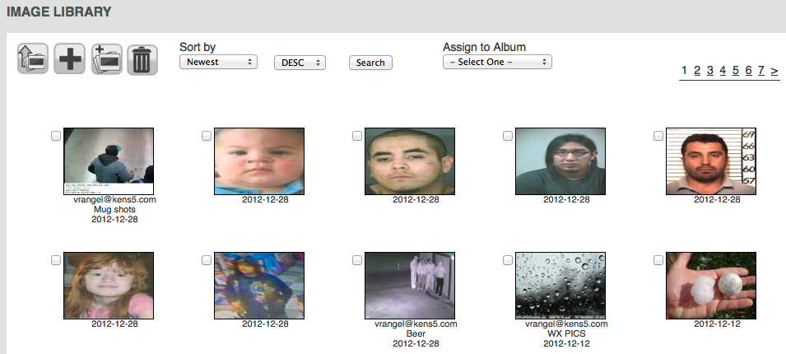
Pixelbling Notes 1-22-2013

Slide 2
PARSED EMAILS: Images emailed yesterday still haven't shown up in image library today. Image Library still not parsing photos consistently. When images are sent to the email mailbox it does not auto update the Image Library. NOTE: It does work if I Click “Add Images From Email” as soon as I email the photos within an hour time frame. But if I wait a few hours and then click “Add Images From Email” it will not parse any new emails sent that day. Viewers will be sending photos at all hours of the day. The logic needs to be: Scan for new emails with photos often. When new photos from emails are present parse the photos automatically. If the email/Photos has already been parsed do nothing OR overwrite the existing photos in library (Not sure which is easier). Do not create multiples of the same image.
IMAGE LIBRARY: Meta data from email and photo does not come through. i.e. The title Subject, Email sender, or filename of each photo. However, The date time stamp is working fine.
AVIARY EDITOR: I clicked on a NEW image to get into image edit mode (Aviary) , and it went to a blank WHITE screen. I had to hit the back button and retry it twice to get it to work. So it worked the second time. When I First try it on a New image, it goes to White screen. The work around is go back to Image Library and click the image again to launch Aviary for a second try. Then it works on the second time. This will be Very Confusing for the user.
AVIIARY EDITOR SAVE: When I edit the image in Aviary, it does not save the image that I Changed. It keeps the original photo as it was uploaded… (Is it possible to “Save As” so that it doesn’t save over the original image, there by creating a new image from the original?)
DASHBOARD,ALBUM,SLIDE: In Slides window when I click on a slide it launches Aviary to edit. (Which is Great by the way) I crop a picture and save. It displays thumbnail as what I cropped but preview shows original with no changes. When I went back to that slide 15 minutes later in the preview window, the image began to Tile. And appeared to take the crop changes I made. Very Odd. *Maybe when you click the image it goes directly to the image library or It prompts the “Crop” slide function (Not the Aviary Tool).
TRANSITIONS: When you select a transition/multiple transitions and click save icon, it does not save your selection. The work around is You have to click once in the grey area, and then click save. This will be and is confusing for the user.
ALBUMS: Created has 3 slides in a Album, but the thumbnail of the album in the Slide Albums area says there's only 1 slide.
IMAGE LIBRARY: Sort by dropdown. "from email" and "subject" sort features appear not to work.
IMAGE LIBRARY: I tried to create a blank slide with the Plus icon for an album, and nothing happened-- it just took me to the dashboard. no blank slide was created. Not Sure what that icon is for? *Maybe remove that icon.
ALBUM: In Album menu we double click an Album, it should launch dashboard. But it doesn’t do anything. Shouldn’t it launch Dashboard?
DASHBOARD: In Slide Window: The Plus icon Info flag should say “Add from Image Library “Not Open Image Library”

Slide 3
RECAP: SERVICE PLANS
SERVICE PLANS: Both Service Plans include the following. You’ll have the capability to receive and organize your photos, create slides, and play them from your PC onto the air.
•Pixelbling Parses photos from the email address(es) and send them to an Image Library. • Viewers submit their photos designated email address. • Image Library that sorts and organizes Photos. • Create Multiple Albums • Fullscreen photo templates with text field • Fullscreen Mode for On Air Broadcast • Upload Pics from desktop • Dynamic Transitions • Editing Tool for Images.
I. STANDARD PLAN $220/mo
This plan is a basic plan that gets your viewer pics straight to the air with ease. Viewers submit their photos to ONE designated email address.
Templates:
•FS Weather Photo w/text
(Generic_WEATHER_PHOTO_Template_960x540)
•FS Generic Photo w/text
(Generic_Blue_PHOTO_Template_960x540)
•FS Birthday Photo w/text
(Generic_Birthday_Template_960x540)
Transitions:
•Cube
•Slide
•Blinds 3D
II. ADVANCED PLAN $350/mo
This plan gets you everything in the Basic plan, plus the capability for much more customization.- Viewers submit their photos to 1-3 designated email address.
Templates:
• FS Weather Photo w/text
(Generic_WEATHER_PHOTO_Template_960x540)
•FS Generic Photo w/text
(Generic_Blue_PHOTO_Template_960x540)
•FS Birthday Photo w/text
(Generic_Birthday_Template_960x540)
•FS Celebrity Birthday w/text
(GENERIC_CELEBRITY_Birthday_Template_960x540)
•FS Headshot / Mug w/text
(GENERIC_HEADSHOT_Template_960x540)
•FS Facebook Text Only
(Generic_FACEBOOK_Template_960x540)
•FS Twitter Text Only
(Generic_Twitter_Template_960x540)
Transitions:
•Turn
• Cube
•Bars 3D
• Slide
• Concentric
• Blinds 3D

