Slide 1

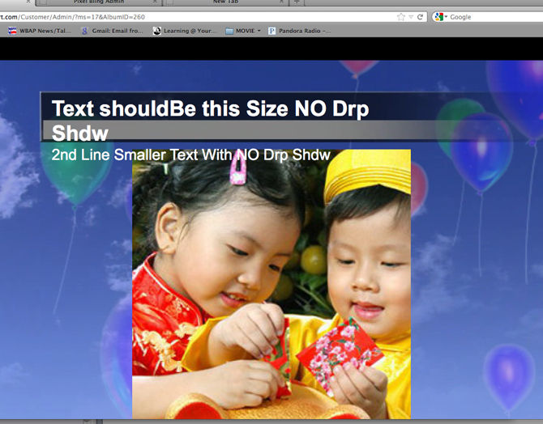
Pixelbling Notes 12-30-2012
Free Trial Is Not Working. It Gets Service II
Google Chrome still does not pre-view Animated bkgs. We should either FIX or exclude any mention of Google Chrome because it does not work. If we can’t get it to work, then Googe needs to be taken out in ALL PSD’, tiff, jpeg, png files and hard code in web site.
Super Admin - Customer Themes – Super Admin will choose Service I or Service II
Need Backup plan for Editing Tool, Not sure what to choose or purchase? We will address at later date, but for now we will continue with aviary. ON HOLD
Min-Requirements" Mozilla before Google Chrome. Fire fox seems to be the MAN or now.
6) Title Bar text returns to next line. Example below. Character limit should be 40.

Slide 2
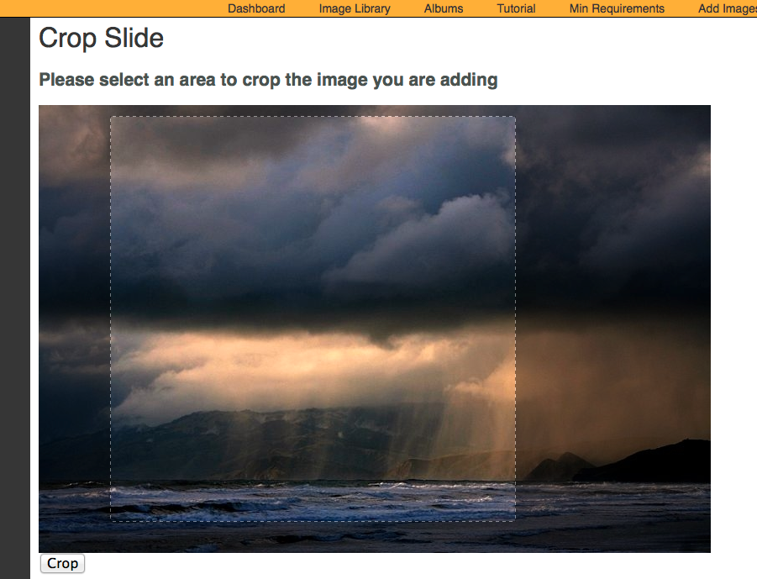
7). Need to revisit the crop aspect ration. Needs to proportionate scale.

Slide 3
RECAP: SERVICE PLANS
SERVICE PLANS: Both Service Plans include the following. You’ll have the capability to receive and organize your photos, create slides, and play them from your PC onto the air.
•Pixelbling Parses photos from the email address(es) and send them to an Image Library. • Viewers submit their photos designated email address. • Image Library that sorts and organizes Photos. • Create Multiple Albums • Fullscreen photo templates with text field • Fullscreen Mode for On Air Broadcast • Upload Pics from desktop • Dynamic Transitions • Editing Tool for Images.
I. STANDARD PLAN $220/mo
This plan is a basic plan that gets your viewer pics straight to the air with ease. Viewers submit their photos to ONE designated email address.
Templates:
•FS Weather Photo w/text
•FS Generic Photo w/text
•FS Birthday Photo w/text
Transitions:
•Cube
•Slide
•Blinds 3D
II. ADVANCED PLAN $350/mo
This plan gets you everything in the Basic plan, plus the capability for much more customization.- Viewers submit their photos to 1-3 designated email address.
Templates:
• FS Weather Photo w/text
•FS Generic Photo w/text
•FS Birthday Photo w/text
•FS Celebrity Birthday w/text
•FS Headshot / Mug w/text
•FS Facebook Text Only
•FS Twitter Text Only
Transitions:
•Turn
• Cube
•Bars 3D
• Slide
• Concentric
• Blinds 3D

Slide 4
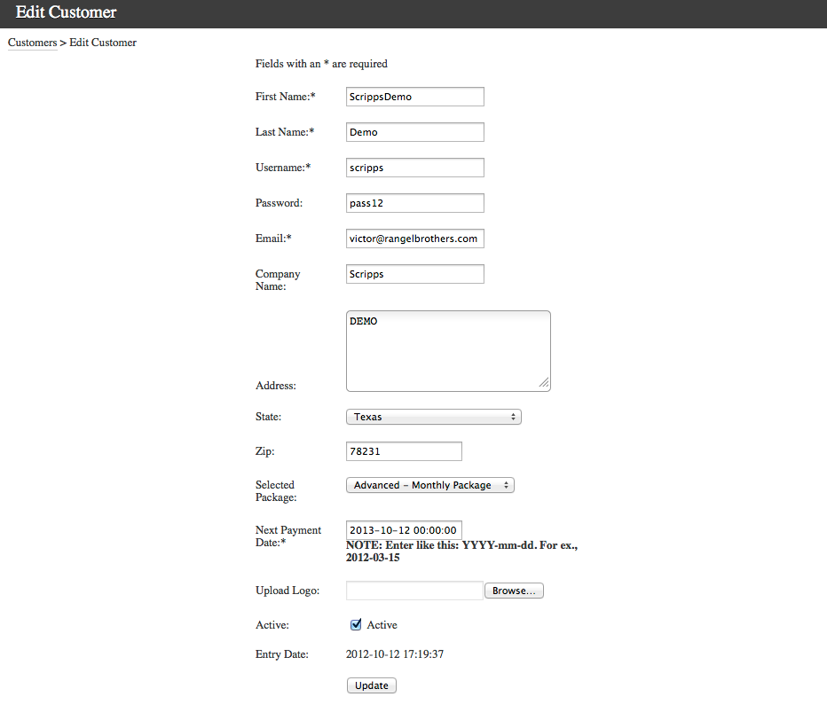
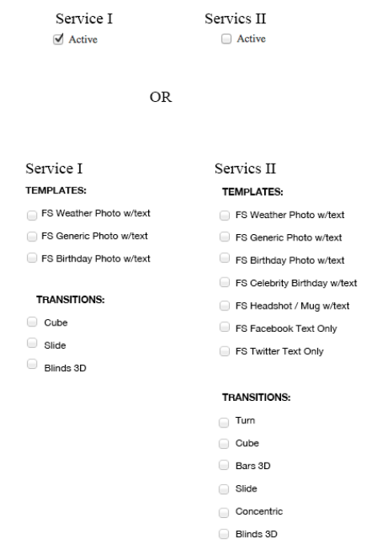
8). In ADMIN Dashboard, Would Like the option of assigning Service I or Service II, to any user that we create through admin. When we do assign Service I or II templates should already appear as blanks. Is this possible?
Is this type of activation possible? Example Below.

Slide 5
8). Continued.

Slide 6
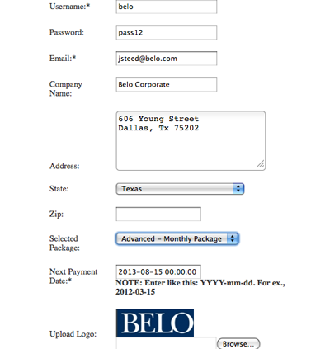
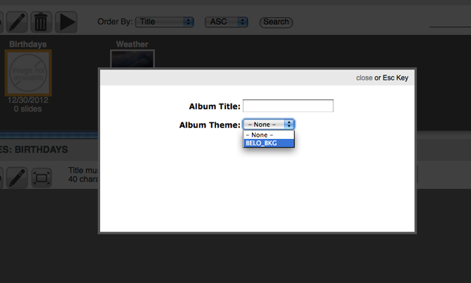
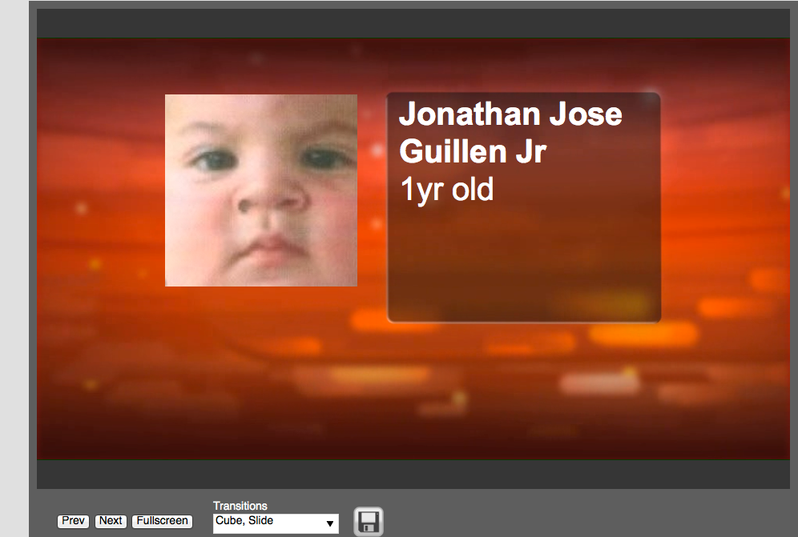
9) Advance Service not showing All of the Album themes. When I create a New Album there is only one theme to choose.
10) Head Shot Template – When in Full Screen Mode, Photo is to small. However the Preview is OK.

Slide 7
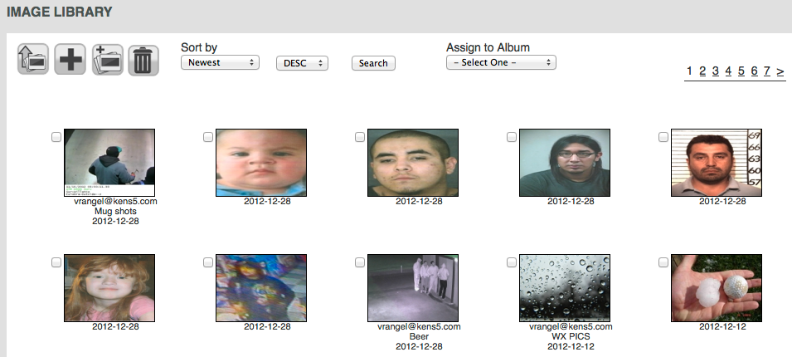
11) Image Library– Meta data on each photo jpeg file does not come through. i.e. The title or filename of each photo. The time stamp is OK.

Slide 8
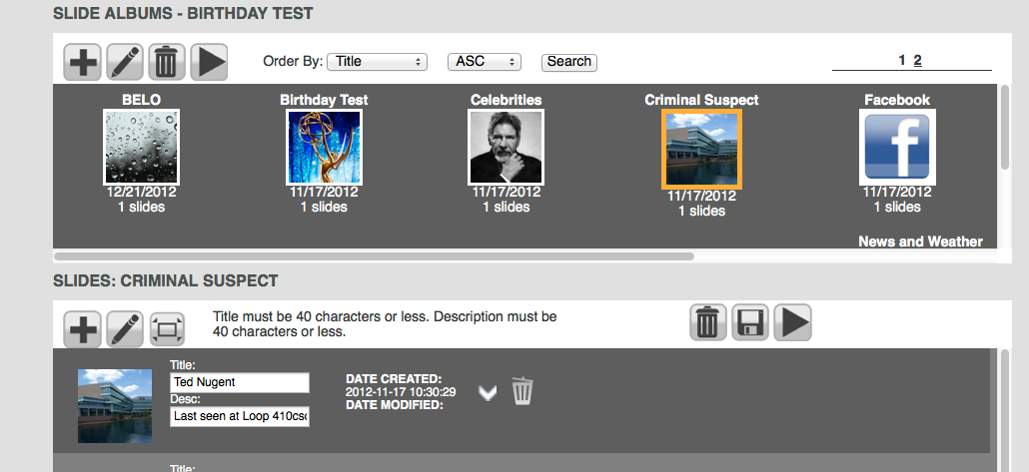
12) Slide Album – “title” does not change according to Album Selected. They should correspond to the Album selected.

Slide 9
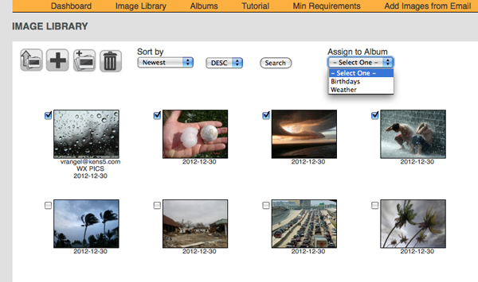
13) Image Library: When user selects images to Add to Album, User can Create New Album, and Choose from Drop Down Menu. Please add “New Album”.
New Album

Slide 10
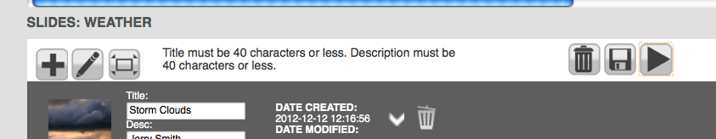
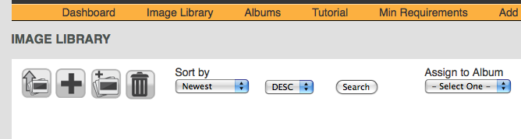
14) Not sure what is “edit icon” does?
15) Not sure what is Add “new blank slide” is?
16) Fullscreen mode should look like the play button. Remove or Move Play button next to Edit icon.

Slide 11
17)Linda tried to create a NEW ACOUNT. It said she already existed. She does not exist because I deleted it last month. Sounds like it still holding on to info.
She then sent a request to send her the password. Nothing was sent.
18) Created NEW ACOUNT test1@pixelbling.com.
Did not send Welcome to Pixelbling. Did not resend password
19) Free Trial does not seem to work. Expiration is set to 0000. Does not let new user log on until Admin changes expiration date. Expiration should be set to a 30 day trial.
19) Free Trial does not seem to work. Expiration is set to 0000. Does not let new user log on until Admin changes expiration date. Expiration should be set to a 30 day trial.

