Slide 1

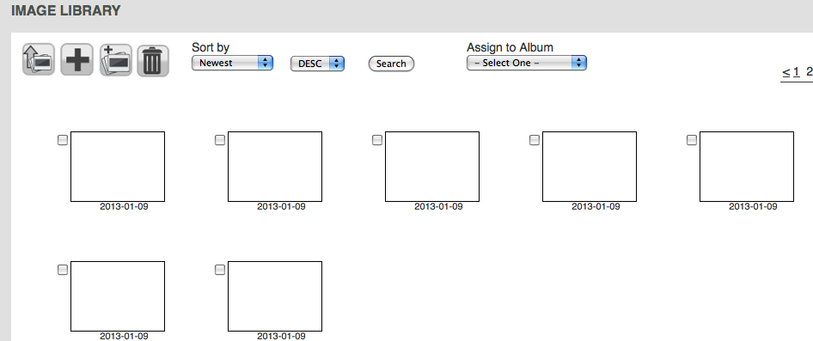
Pixelbling Notes 1-8-2013
1) Scripps account has 10 templates… How do we delete or add new templates?
We are Getting Blank Thumbnails when I send to iwitness@pixelbling.com

Slide 2
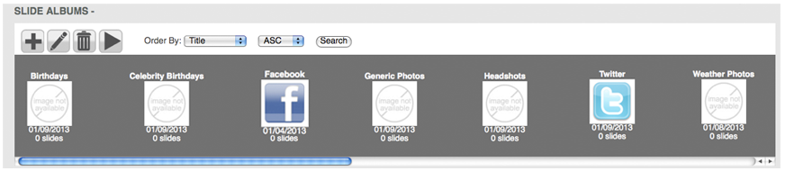
When someone creates an account with Free trial OR Service I or Service II,
I would prefer that there would be blank ALBUMS already Pre-Loaded in the ALBUMS Window (With Zero Slides). But I am not sure if this was a “new item” or how difficult this would be for coding?
The Albums would be labeled like this. (This is Service II
• WEATHER PHOTOS
•GENERIC PHOTOS
•BIRTHDAYS
•CELEBRITY BIRTHDAYS
•HEADSHOT
•FACEBOOK
•TWITTER

Slide 3
RECAP: SERVICE PLANS
SERVICE PLANS: Both Service Plans include the following. You’ll have the capability to receive and organize your photos, create slides, and play them from your PC onto the air.
•Pixelbling Parses photos from the email address(es) and send them to an Image Library. • Viewers submit their photos designated email address. • Image Library that sorts and organizes Photos. • Create Multiple Albums • Fullscreen photo templates with text field • Fullscreen Mode for On Air Broadcast • Upload Pics from desktop • Dynamic Transitions • Editing Tool for Images.
I. STANDARD PLAN $220/mo
This plan is a basic plan that gets your viewer pics straight to the air with ease. Viewers submit their photos to ONE designated email address.
Templates:
•FS Weather Photo w/text
(Generic_WEATHER_PHOTO_Template_960x540)
•FS Generic Photo w/text
(Generic_Blue_PHOTO_Template_960x540)
•FS Birthday Photo w/text
(Generic_Birthday_Template_960x540)
Transitions:
•Cube
•Slide
•Blinds 3D
II. ADVANCED PLAN $350/mo
This plan gets you everything in the Basic plan, plus the capability for much more customization.- Viewers submit their photos to 1-3 designated email address.
Templates:
• FS Weather Photo w/text
(Generic_WEATHER_PHOTO_Template_960x540)
•FS Generic Photo w/text
(Generic_Blue_PHOTO_Template_960x540)
•FS Birthday Photo w/text
(Generic_Birthday_Template_960x540)
•FS Celebrity Birthday w/text
(GENERIC_CELEBRITY_Birthday_Template_960x540)
•FS Headshot / Mug w/text
(GENERIC_HEADSHOT_Template_960x540)
•FS Facebook Text Only
(Generic_FACEBOOK_Template_960x540)
•FS Twitter Text Only
(Generic_Twitter_Template_960x540)
Transitions:
•Turn
• Cube
•Bars 3D
• Slide
• Concentric
• Blinds 3D

Slide 4
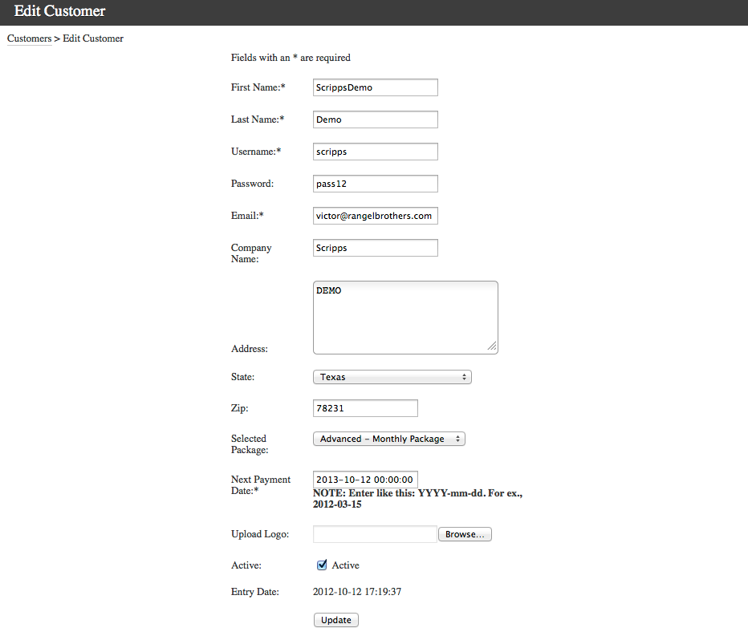
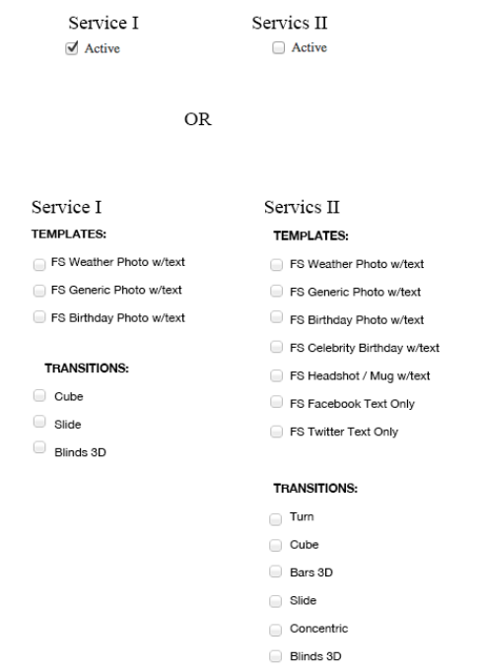
8). In ADMIN Dashboard, Would Like the option of assigning Service I or Service II, to any user that we create through admin.
Is this type of activation possible? Example Below.

Slide 5
8). Continued.

Slide 6
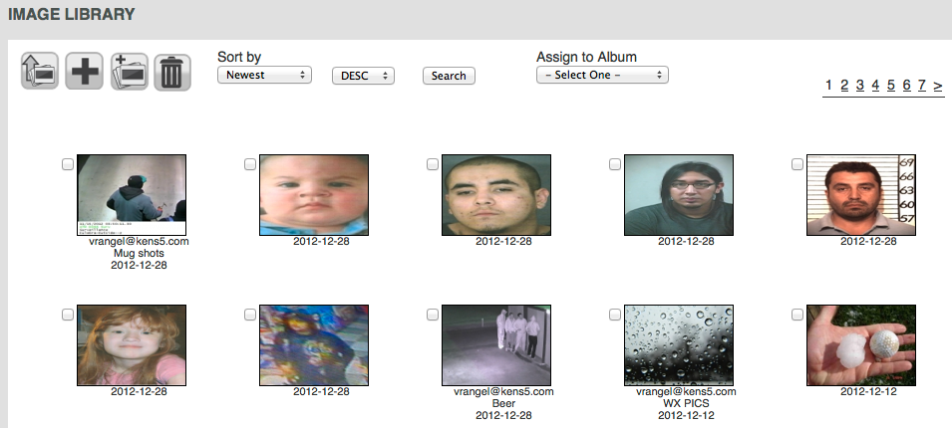
11) Image Library– Meta data on each photo jpeg file does not come through. i.e. The title or filename of each photo. The time stamp is OK.

Slide 7
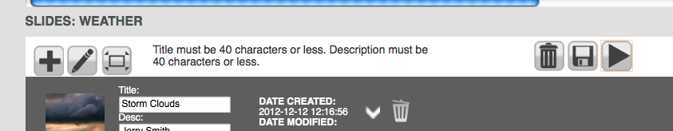
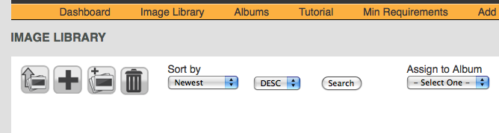
14) Not sure what is “edit icon” does?
15) Not sure what is Add “new blank slide” is?
16) Fullscreen mode should look like the play button. Remove or Move Play button next to Edit icon.

