Slide 1


Overview for KTEN News
www.pixelbling.com
User: wtxl
Password: pass12
Send Test Photos to: wtxl@pixelbling.com

Slide 2
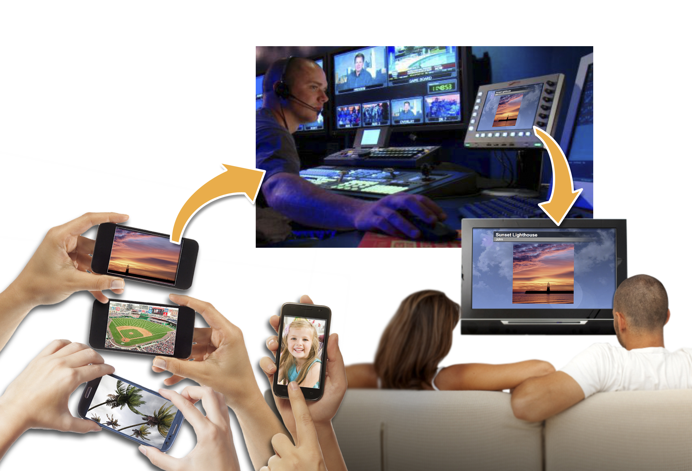
Maximize User Generated Content (UGC)
Access to viewer (UGC) photos instantly
Easy to use web app. CG through the web.
Quickly get content from YOUR viewers for On-Air
Build a community of citizen journalists
Crowd-sourced, real time News
Maximize newsgathering resources
*The Smart Phone
Nearly half the U.S. Population use smart phones and that’s over 130 million smart phones in use. The majority of the mobile phone imagery submitted to local News outlets are weather and event related. The beauty of phone photography is the speed & versatility. All this User Generated Content (UGC) can be accessed and compiled with your brand, On-Air and Online using Pixelbling while generating revenue.

Slide 3
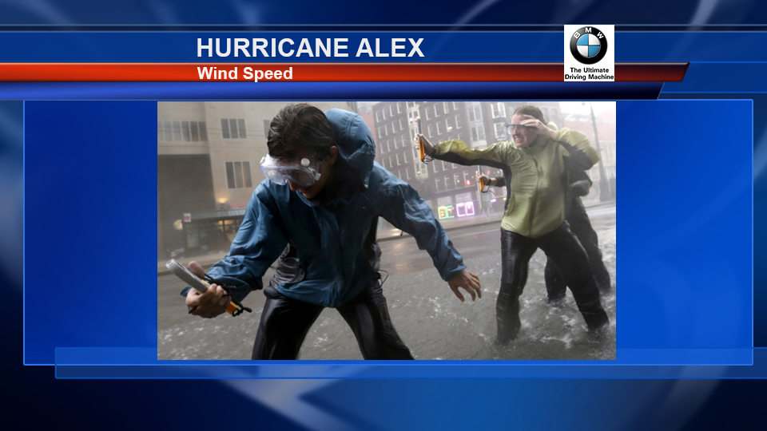
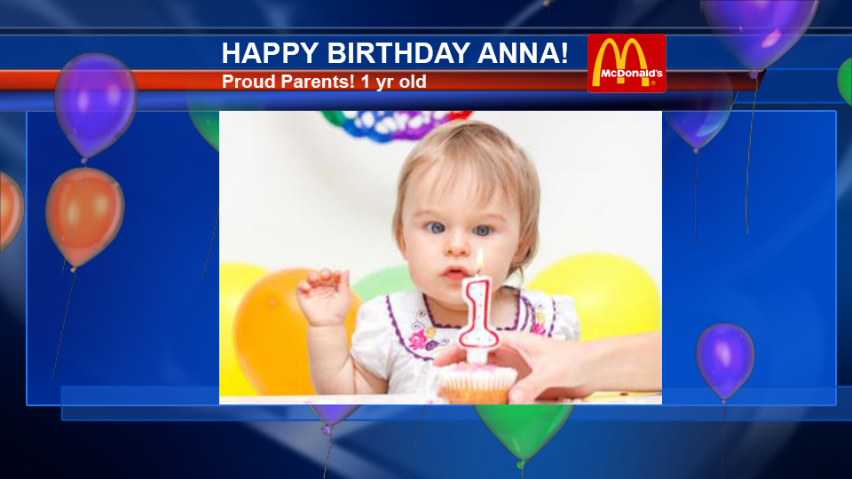
Generate Revenue
Generate revenue through sponsorship
Promote weather brand
Easy to tag any sponsored logo to a full screen
Monetize content through advertising and sponsorships
Sponsor multiple channels like Weather, Birthdays and Local events
Monetization Opportunities:
  Channel Sponsorship:
  Channels can be sold separately or on a run of site basis. Ad sizes and graphics are totally customizable. Increase value for your advertisers by providing targeted demographics. Weather, News, Sports, Kids, Pets…or create a campaign specific channel.
  Contest: Sponsored Contests allow your sales team to create fun, interactive marketing packages that build client-customer relationships. Registration data can be tailored to build a valuable database of qualified leads. Rules and terms of service are determined by you and your clients.

Slide 4
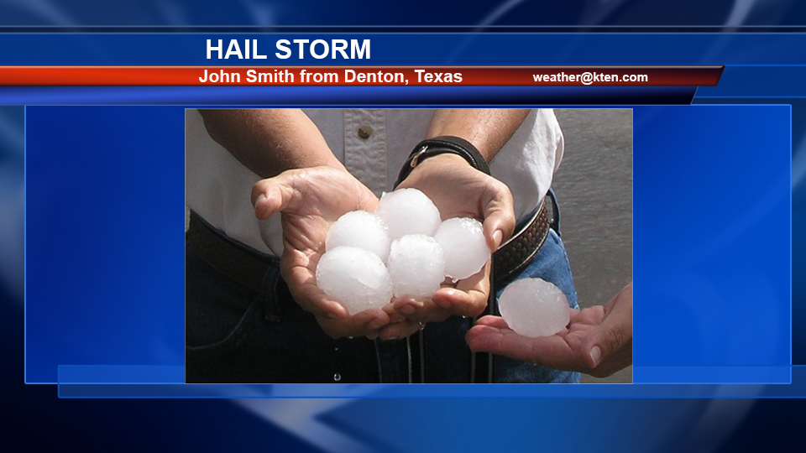
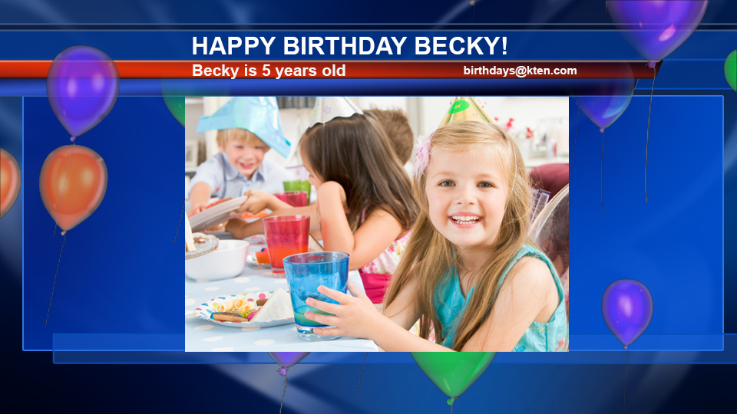
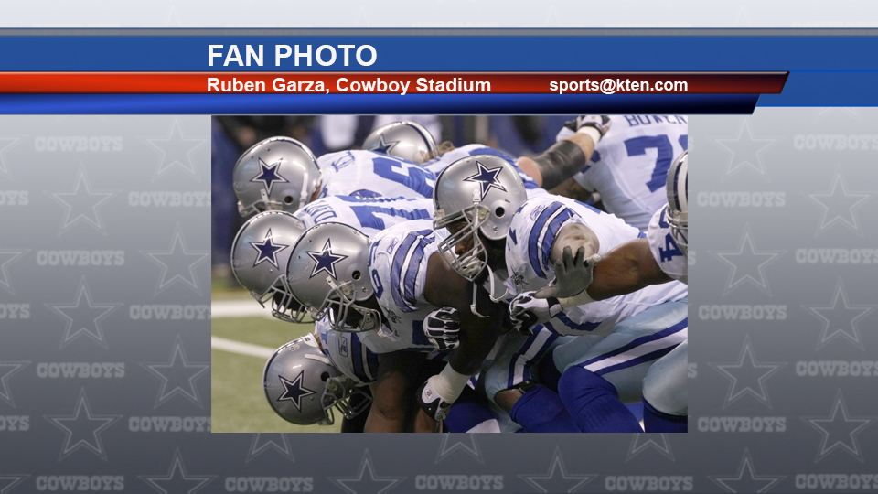
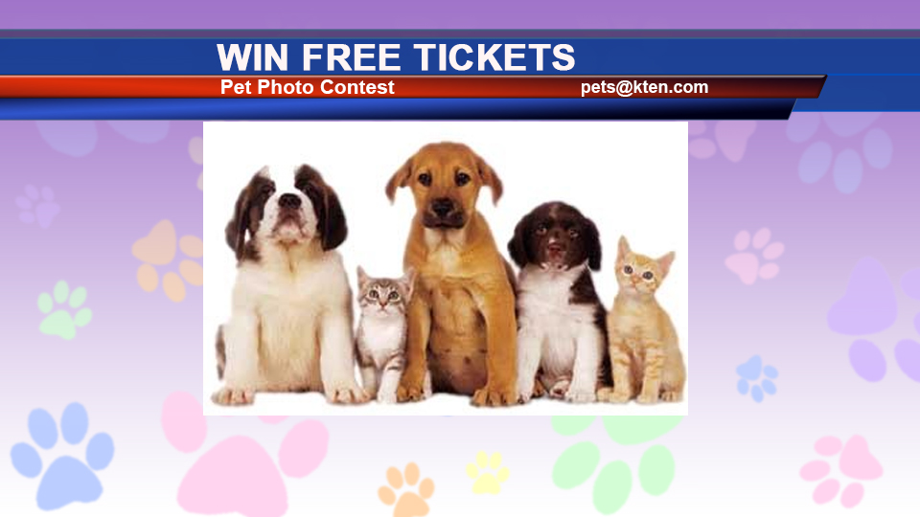
Engage Your Audience
Engage and grow your audience through local events. Brand specific channels like:
Severe Weather
Sporting Events
Birthdays
Contest
*Custom background or template
Pixelbling can customize a animated background template that reflects the style guide of your news station or business. We have seasoned professional graphic artist that understand News Formats. You can send us the backgrounds, or our designers can make one for you. Just send us your request at info@pixelbling.com or use the Submit Request page. It would also help if you could attach a jpeg or PSD so that we can design according to your style guide or color palette.

Slide 5

Graphics Solution
CG through the WEB. No Graphic Artist needed.
For producers! Pixelbling can also bridge the gap for those early morning shows and those weekend shows that are NOT fully staffed with an Artist while reducing your creative cost. CG through the web, easy to use web app. There is NO complicated software to download or to learn and it is very easy for producers to use.
Producer Friendly: Producers can add text titles, body copy and images to their slides quickly.
Multimedia Options: Producers can screen, select and use Mobile Imagery when making decisions about what goes on the air. Quickly moving content received from viewers and the Internet to On- Air is the primary benefit of Pixelbling.
Edit Graphic tools: Producers can quickly edit any graphic in the Image Library.
Custom Branded Graphics: We create custom animated backgrounds for your TV stations which are automatically merged with Album play lists. This dramatically reduces turn-around time eliminating the need for Graphic Artists and CG Operators.
If you have other questions please send us an email at info@pixelbling.com

Slide 6
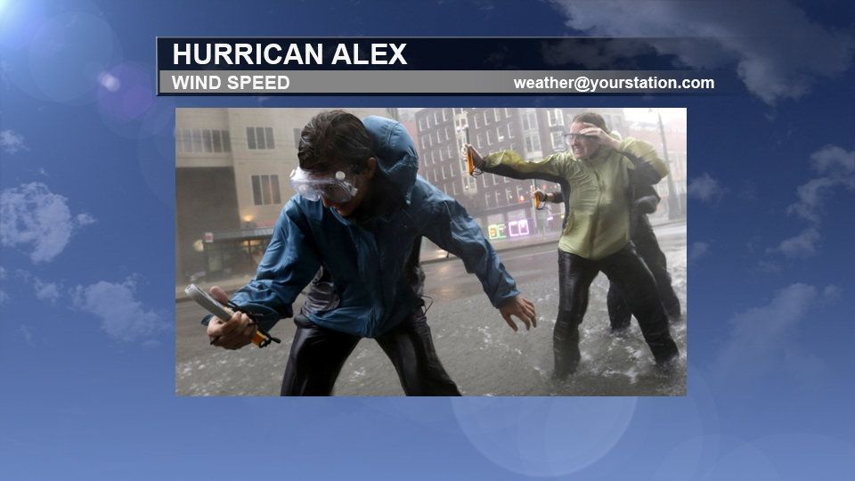
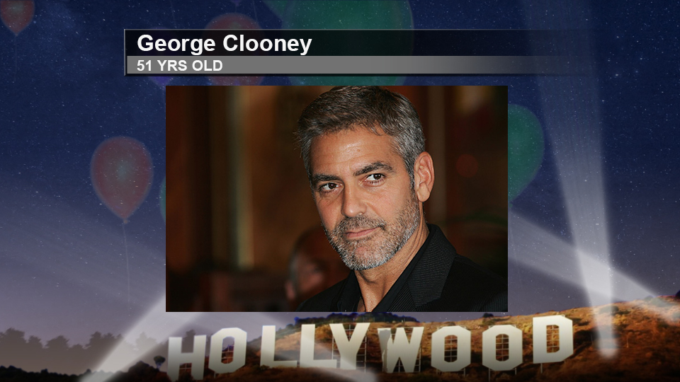
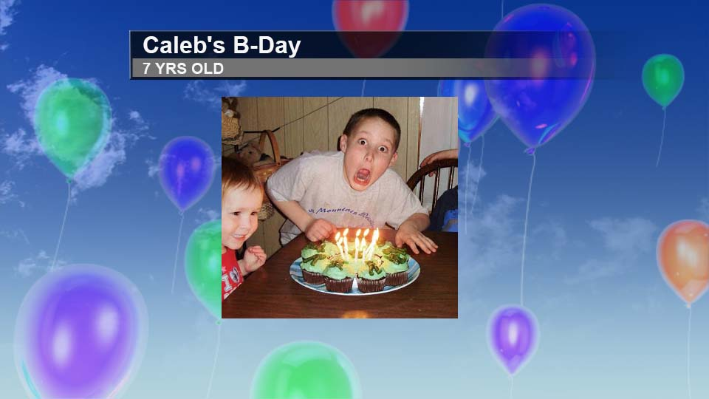
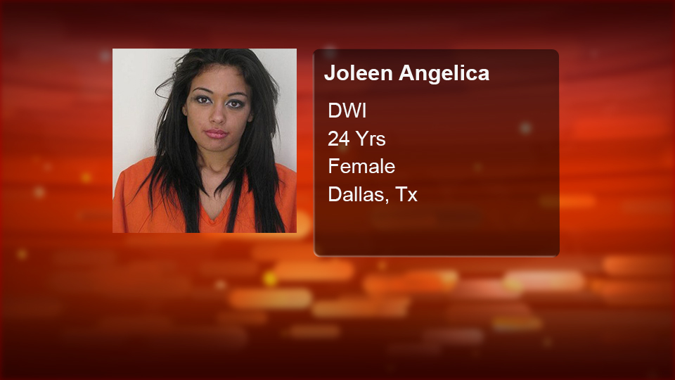
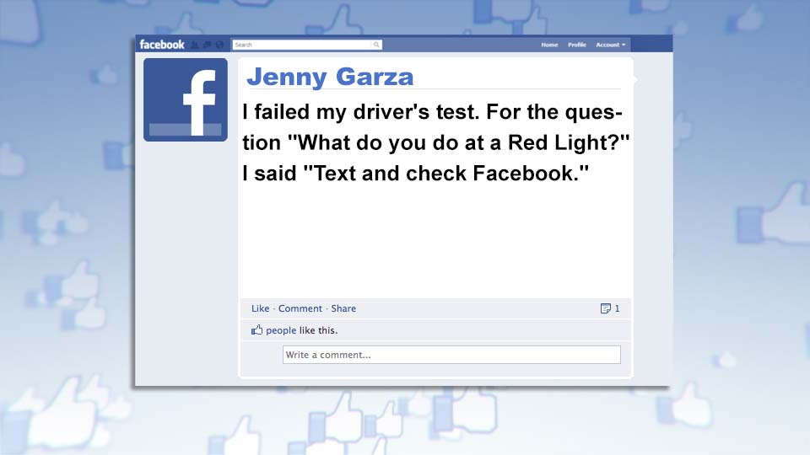
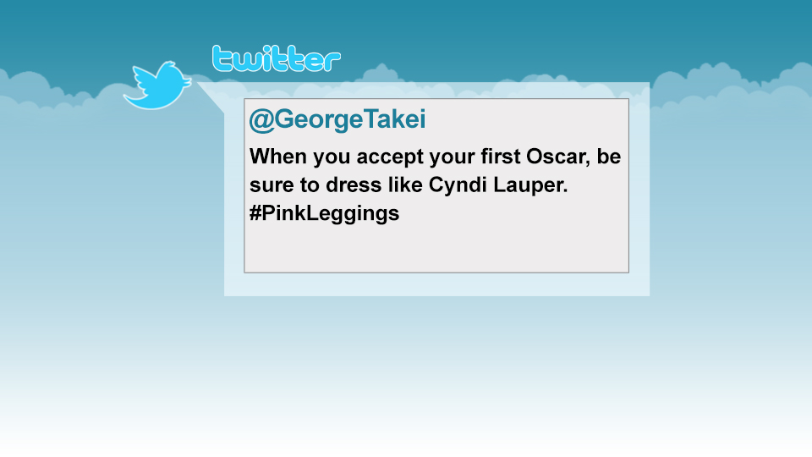
Template Examples
Here are 6 templates that come with the advanced package: We can also create custom templates with your on air style or anything that will fit your needs. You can sponsor any of the templates.
Weather
Celebrity Birthdays
Birthdays
Mug shots
Facebook
Twitter
Send us an email info@pixelbling.com

