Slide 1
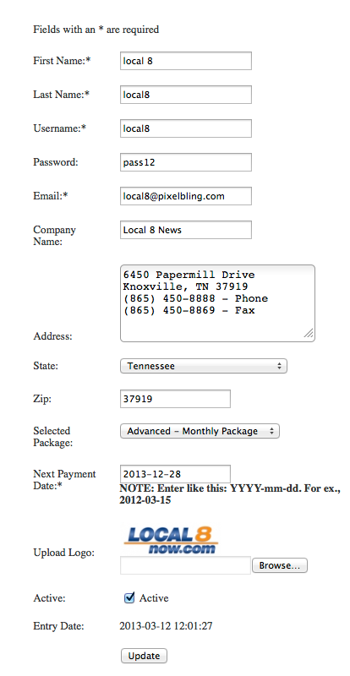
How to Create an Account for Clients
1.CLIENT / FOX 44-KWKT http://www.kwkt.com
STEP 1: Make Email Address in Hostmonster: FOX44@pixelbling.com The password should be p@1nt1ng when Hostmonster ask for a password.
STEP 2: Set Up account in for Fox 44 in the Admin Section, Log On to: http://www.pixelbling.com/Admin/LogIn/
USER: admin PASWORD: pass12
STEP 3: Create Customer>Fill out the Fields.
*Note: Lets keep it simple. Make all the names the same: fox44
Password is always: pass12
This is the email account you set up in Hostmonster. The email password should be p@1nt1ng
Put there address and Phone numbers.
Always pick Advanced Monthly Service
Always use Payment date: 2013-12-28
Always upload their logo as jpeg
Always select Active
Always click Update

Slide 2
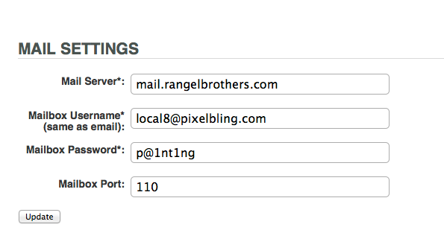
STEP 4: Once the email account has been created in Hostmonster, You will need to Set the Mail Settings in pixelbling account. Log in as the user fox44, pass12. Go to MyAccount > MailSettings > Edit. Below is the info you will put in. Click update when finished.

Slide 3
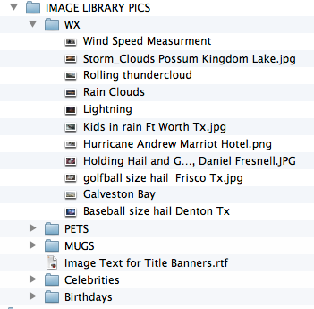
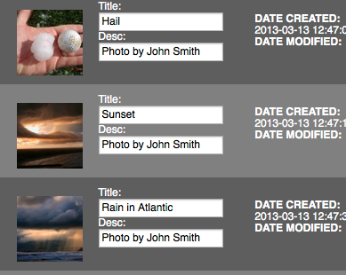
STEP 5: Send Images to the new account you set up FOX44@pixelbling.com .
You will email images that was zipped to you. Do Not email everything in one blast. Email them in categories like Birthdays, Weather, Celebrities, Mugs, Pets, Facebook and Twitter.
STEP 6: When the images arrive and parse, You will need to add images to the albums Birthdays, Weather, Celebrities, Mugs.
Then title each one according to the text document Image Text for Title Banners. You will also have to add body copy for Facebook and Twitter. Just copy and paste each line from the the text doc. This is to help show the client how it will work and look.

Slide 4
Image Text for Title Banners.rtf
BIRTHDAYS:
Happy B-Day Stephanie
1 yr
Grandpa
89 yrs
John John
1 yr
Caleb's B-Day
6 yrs
Katy Lyn's Birthday
6 Years Old
CELEBRITIES:
Angelina Jolie
37
Brad Pitt
49
George Clooney
51
Will Smith
44
Nicole Kidman
45
HEADSHOTS:
Hugh Grant
lewd conduct in a public place
Juan Negret
Theft
Lindsay Lohan
stealing a necklace
Joleen Angelica
DWI
Randy Travis
intoxication
PETS:
Birthday cat
3 yrs
My Birthday Cat
Sad
Kissing freinds
Charlie and Mittens.
Puppy tricks
Peppito
Birthday Cat!
Salvador
WEATHER:
Golfball size hail
Frisco Tx
Hurricane Andrew
Marriot Hotel.
Holding Hail and Golfball
Daniel Fresnell
Kids in rain
Ft Worth Tx
Storm Clouds
Possum Kingdom Lake
Baseball size hail
Denton Tx
Galveston Bay
Palm Trees
Lightning
San Antonio
Rain Clouds
Gulf of Mexico
Rolling thundercloud
Downtown
Wind Speed Measurment
Hurricane Isaac
FACEBOOK:
John Allen
Gas prices aren't really that bad when you remember that you're essentially buying badass dinosaurs in liquid form.
Jenny Garza
I failed my driver's test. For the question "What do you do at a Red Light?" I said "Text and check Facebook.”
Jacob Langley
Some days, the best thing about my job is that the chair spins.
TWITTER:
‏‪@TheBatman
I will be breaking exactly 3.14 bones in every perp’s face tonight. Happy Pi Day, Gotham.
‪@GeorgeTakei
When you accept your first Oscar, be sure to dress like Cyndi Lauper. ‪#PinkLeggings
‪@TheRealNimoy
I hear my Vulcan people have a new home. True ? LLAP
‪@CNN
Another problem with a Carnival cruise - all passengers will be flown home: ‪http://on.cnn.com/ZQKAyr
‪@CNN
Pope Francis took name in honor of St. Francis of Assisi - more notes in our live blog: ‪http://on.cnn.com/14Xsudq

