Slide 1

FAQS
What is Pixelbling?
Pixelbling is a Newsroom product that allows producers to quickly gather User Generated Content (UGC) from your viewers and then display it online and on-air. We understand that in this age of consolidating media and shrinking news staffs, getting local and breaking news is an increasing challenge. Our focus is on newsgathering Mobile Imagery and promoting your stations branding. Pixelbling provides a way for your audience to quickly and easily share mobile imagery of Weather, News and community events that are important to them. Your viewers become a resource as news gathers and UGC providers. In today’s competitive television news environment, you can’t win the big stories without the right tools. Pixelbling enables your audience to submit mobile imagery content from their mobile devices with ease while giving your station access to user submitted content in an online and on-air format in about 30 seconds. Stay ahead of the competition with immediate access to visual and compelling content with Pixelbling.
Pixelbling will help engage users and show their photos
Reduce your graphic creative cost
Reduce your content acquisition costs
Grow and Engage your audience
Build a community of citizen journalists
Win your TV news rating war.
How to use Pixelbling
The best way to use Pixelbling is prompting your viewers send photos to the TV stations designated email address. Viewers take photos with their smart phones or cameras of important Weather and local events that the station can use on air for broadcast through the control room. User generated Content or UGC is a powerful way to engage and grow your audience. The photos are then compiled in Pixelbling into an Image Library as slides where you can review all the incoming content approve or delete. Our platform allows you to capture, moderate and publish user generated news. Pixelbling is a interactive website that is customizable for a producer to generate a graphic an encourage viewers, to participate in telling the story.
Multi Media Options: Producers can screen, select and use Mobile Imagery when making decisions about what goes on the air. Quickly getting content from the viewers, Internet to Air is the primary benefit of Pixelbling.
Internet to Air: When content is posted on the Pixelbling platform, producers have instant access to a suite of features including Album playlist selection, font entry and on-air display.
Branded Graphics: We create custom backgrounds for TV stations which are automatically merged with Album playlists. This dramatically reduces turn-around time eliminating the need for Graphic Artist and CG Operator.
The Smart Phone
Nearly half the U.S. Population use smart phones and that’s over 130 million smart phones in use. The majority of the Mobile Phone Imagery submitted to local News outlets are weather and event related. The beauty of phone photography is the speed & versatility. All this User Generated Content (UGC) can be accessed and compiled with your brand, On-Air and Online using Pixelbling

Slide 2
What are templates?
Templates are made to showcase a specific subject matter like Weather, Head shots, Birthdays, Facebook, Twitter and so on. They help the viewers to understand what they are looking at.
The Standard Plan has these 3 Templates: 1.Weather Background with Photo and text 2. Generic Background with Photo and text, and 3.Birthday Background with Photo and text. The 3 Transitions are 3D Cube, Slide and 3D Blinds.
The Advanced plan has these 7 Templates: 1.Weather Background with Photo and text, 2.Generic Background with Photo and text , 3.Birthday Background with Photo and text, 4.Celebrity Birthday Background with Photo and text, 5.Headshot Background with Photo and Text 6.Facebook Background with Text Only, and 7.Twitter Background with Text Only. The 6 transitions are 3D Cube, Slide, Page Turn, 3DBars, Concentric, and 3D Blinds.
What if I need a custom background or template?
Pixelbling can customize a background animation or template that reflects the style guide of your news station or business. We have seasoned professional graphic artist that understand News Formats. You can send us the backgrounds, or our designers can make one for you. Just send us your request at info@pixelbling.com or use the Submit Request page. It would also help if you could attach a jpeg or PSD so that we can design according to your style guide or color palete.
How do I set up my mailbox?
In order to receive your viewer pictures, Pixelbling will need the mailbox information to connect to the designated email address. If you don’t know this information, you can get it from your Technical Administrator who handles all of your email accounts.
Here is an example of what it might look like.
Mail Server: mail.youraddress.com (Your mail server address will be provided by your technical Administrator.)
Mailbox Username: yourname@yourcompany.com (This is the email address that viewers are sending photos to.)
Email Mailbox Password: This is the password used to access the email address.
Mailbox Port: Usually port 110 works, but your Technical Administrator will know for sure.
Should I us a Mac or a PC?
You can use either a Mac or a Windows platform desktop or laptop. For best results these are the minimum requirements we suggest when using Pixelbling.
Windows XP, 7, 8, Pentium 2.53 Ghz RAM: 4GB, Recommended Web Browser: Mozilla Firefox
OSX 10.6, 10.7, 10.8, Pentium 2.53 Ghz, RAM 4 GB, Recommended Web Browser: Mozilla Firefox
Display Monitor: Any wide screen: 19" 20" 22" 24" 27” and bigger. Scan Resolution: 1280 x 720, 1440 x 900, 1920 x 1080

Slide 3
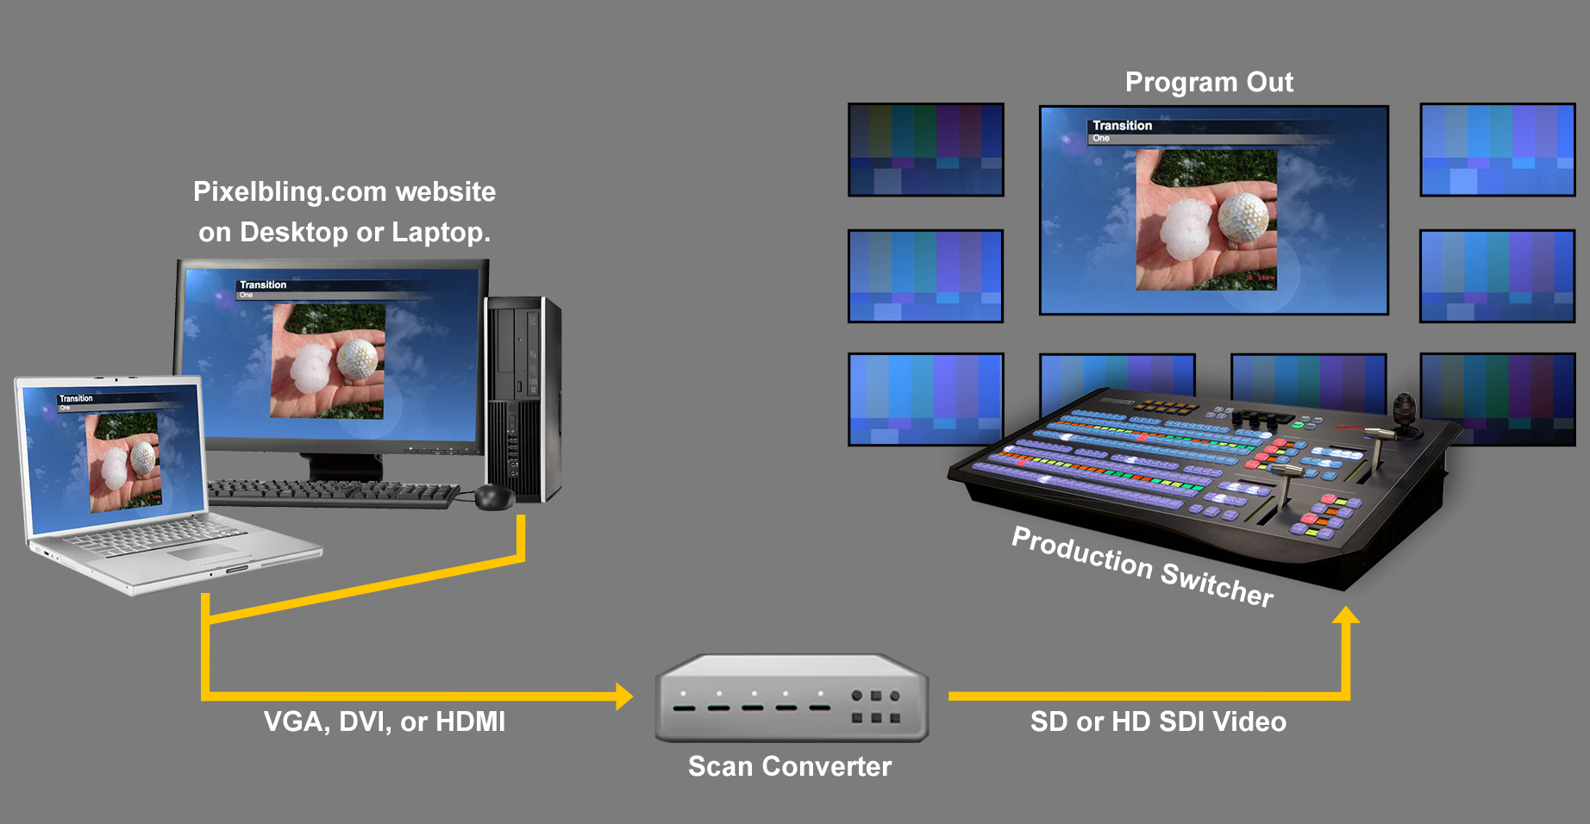
What is a scan converter?
Most facilities are set up to view a PC desktop as a video source using a Scan Converter. There are many to choose from but you MUST KNOW which one will work best with your set up. If you currently do not have one speak with your Tech dept or we suggest your Tech dept contact us at support@pixelbling.com. However we currently use BrightEye Mitto 3G/HD/SD Scan Converter. The website is: http://www.ensembledesigns.com This schematic shows how to connect it. The PC is connected to a scan converter, the scan converter is connected to a production switcher.
If you have other questions please send us a email at support@pixelbling.com or info@pixelbling.com and we will get back to you shortly. Thank you for choosing Pixelbling.

