Slide 1

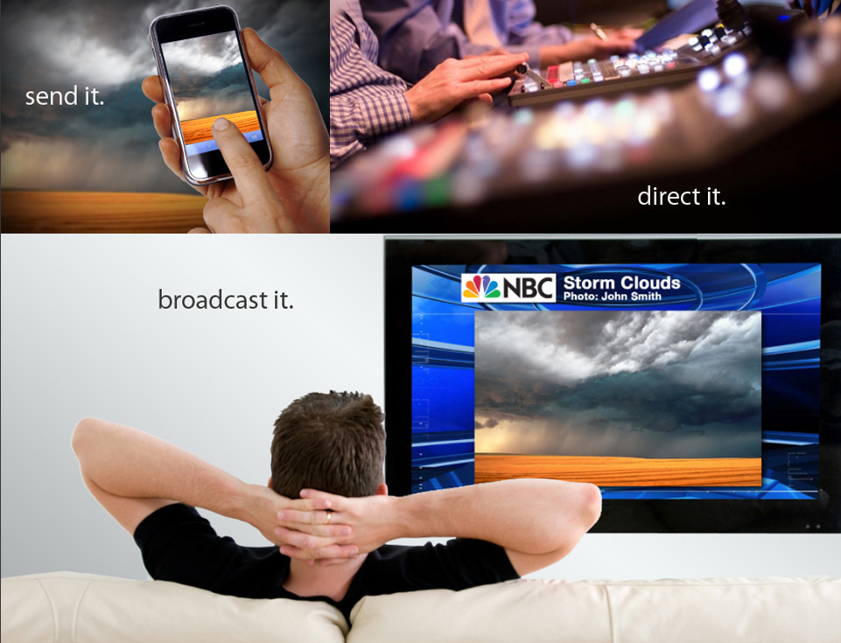
User Guide

Slide 2
pixelbling User Guide
Contents
Product Overview
  Audience and ratings Growth Capabilities
  Social Media Integration
  Graphics Capabilities
  On Air Production Capabilities
Minimum Requirements
    Fro best results
Create Account
  User name and password
  Pick a Service Plan
Mailbox Settings
  Designated Email Address
  Mailbox Info
Image Library Upload
  Add Images From Email
  Upload Image Icon
Image Editor
  Functions
Albums
  Build an Album
  Select a template theme
  Sort Albums
Themed Templates
  Template Description
  Standard Plan
  Advanced Service Plan
  Customized templates
  Submit Request

Slide 3
pixelbling User Guide
Contents
Add Images to Album
  Add Image Icon
  Crop Slide Page
Dashboard
  Dashboard has three sections
  Albums
  Slides
  Preview & Full Screen Mode
Technical Broadcasting
  Schematic Chart
For More Info
  Email us at support@pixelbling.com or info@pixelbling.com

Slide 4
pixelbling User Guide
Product Overview
Pixelbling is a Newsroom product that allows producers to quickly gather User Generated Content (UGC) from your viewers and then display it online, and on-air. We understand that in this age of consolidating media and shrinking news staffs, getting local and breaking news is an increasing challenge. Our focus is on newsgathering Mobile Imagery and promoting your stations branding. The beauty of phone photography is it's speed & versatility. Pixelbling provides a way for your audience to quickly and easily share mobile imagery of news and community events that are important to them. Your viewers become a resource. In today’s competitive television news environment, you can’t win the big stories without the right tools. Pixelbling enables your audience to submit mobile imagery content from their mobile devices with ease while giving your station access to user submitted news in an online and on-air format in about 30 seconds. Stay ahead of the competition with immediate access to visual and compelling content with Pixelbling.
Audience and Ratings Growth Capabilities
Pixelbling will help Grow and Engage your audience
Email Submission: The ability to acquire content via email is critical when the Big Story breaks, knowing who to contact is equally important.
Build a community of citizen journalists
Entry technology allows broadcasters to maximize content submissions, especially during live breaking news and severe weather coverage.
Win your TV news rating war
Social Media Integration
Follow the Audience: People post content wherever and whenever they like
Newsroom of the Future: By aggregating social media into a single editorial platform, producers are now able to select content from multiple
Creating a branded email address. It is a great way to market and promote specific category events. You can promote seasonal initiatives like weather and community events, sporting events, and many others. Examples: birthdays@yourstation.com, weather@yourstation.com, sports@yourstation.com, etc, etc.
Graphics Capabilities
Pixelbling can bridge the gap for those early morning shows and those weekend shows that are NOT fully staffed with an Artist
Preview your Albums then GO to Air with a Full Screen click.
Dynamic Transitions
Font entry
Reduce your graphic creative cost
Simple image edit tool that allows you to Rotate, Flip, Brightness and Contrast
Pixelbling is a interactive website that is customizable for a producer to generate a graphic an Encourage viewers, to participate in telling the story.
No Software to download
On Air Production Capabilities:
Multi Media: We enable producers to screen, select and use social media when making decisions about what goes on the air. Quickly getting content from the Internet to On-air Production.
Internet to Air: When content is sent to the Image Library, producers have instant access to a suite of features including album selection, font entry, Image edit tool and on-air preview.
Branded Graphics: Stations create custom backgrounds which are automatically merged with album templates. This dramatically reduces turn-around time eliminating the need for art department and control room production.

Slide 5
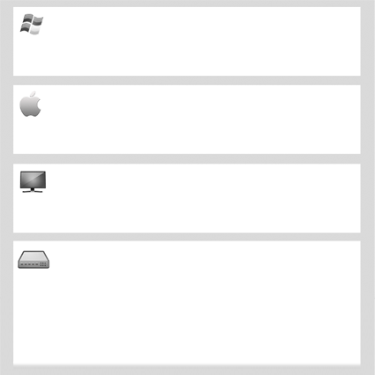
pixelbling User Guide
Minimum Requirements
For best results these are the minimum requirements we suggest when using pixelbling.
Windows XP, 7, 8
Pentium 2.53 Ghz
RAM: 4GB
Web Browsers 1: Mozilla Firefox
Web Browsers 2: Google Chrome
OSX 10.6. 10.7, 10.8
Pentium 2.53 Ghz
RAM: 4GB
Web Browsers 1: Mozilla Firefox
Web Browsers 2: Google Chrome
Wide Screen: 19”, 20”, 22”, 24”, 27” Plus
Scan Resolution: 1280x720, 1280,1024, 1440x900, 1920x1080
Note: 4:3 Screens can work but the settings will have to tweaked to find the best ratio.
Scan Converters: Most facilities are set up to view a PC desktop as a video source using a Scan Converter. There are many to choose from but you MUST KNOW which one will work best with your set up. If you currently do not have one speak with your Tech dept or we suggest your Tech dept contact us at support@pixelbling.com
However we currently use BrightEye Mitto 3G/HD/SD Scan Converter. The web site is: www.ensembledesigns.com/
*Please note that BrightEye may not work with your system setup or facility and that pixelbling is not responsible for any waranties OR tech support concerning BrightEye Scan Converters.

Slide 6
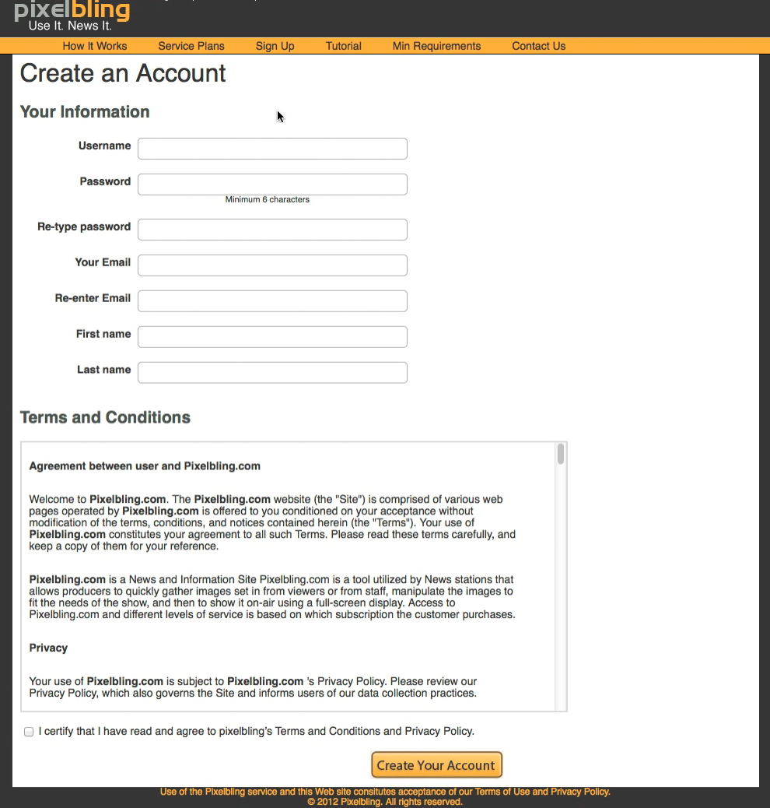
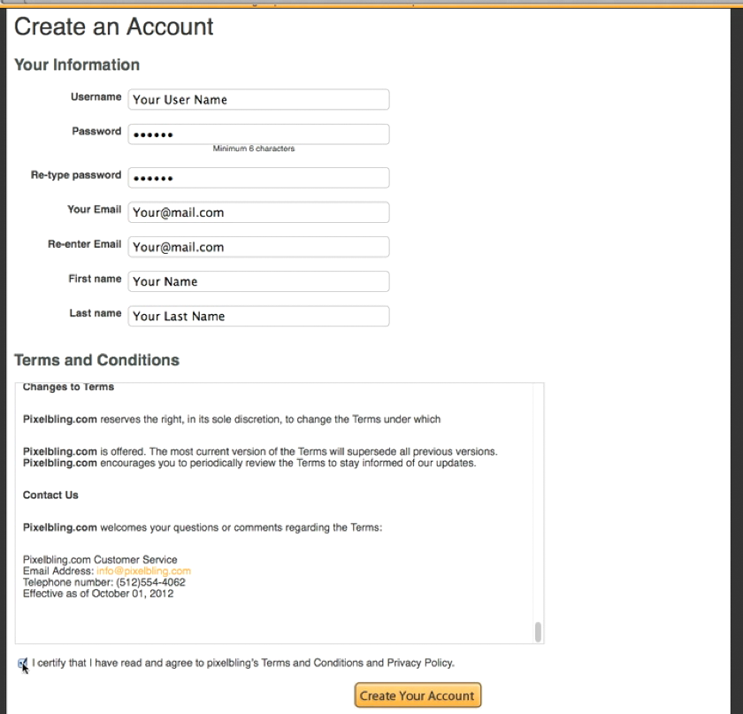
pixelbling User Guide
Create Account
Start from Pixelbling.com and click Sign Up.
On this page, you will create a username and password, and fill out all your information. Make sure to read our Terms and Conditions-- and if you agree to them, check the box and click “Create Your Account.”
Make sure to read our Terms and Conditions-- and if you agree to them, check the box and click “Create Your Account.”

Slide 7
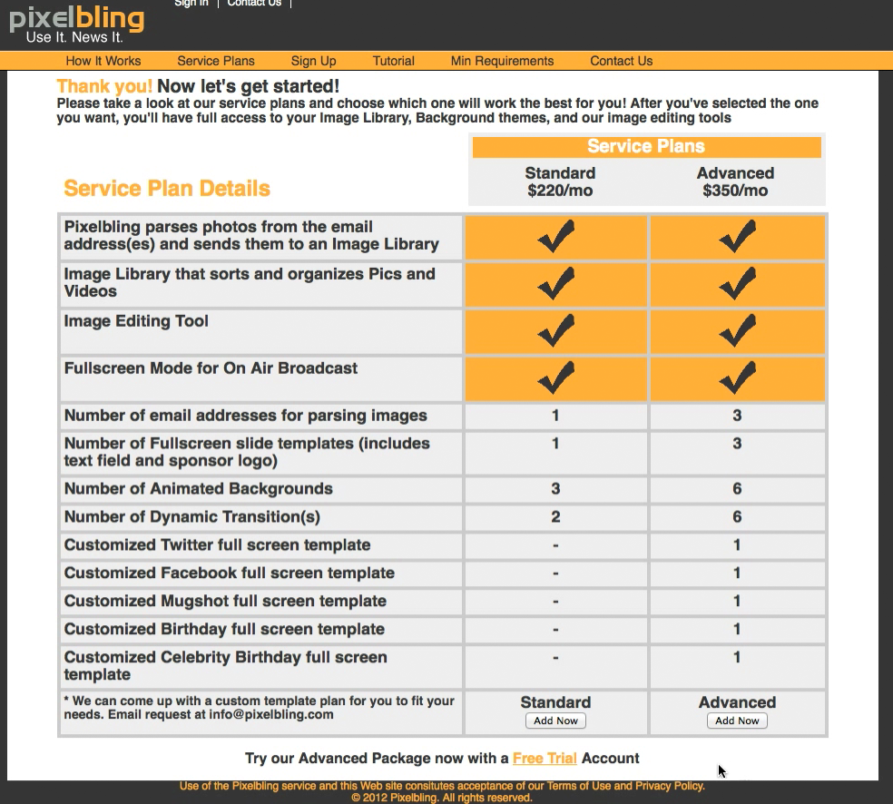
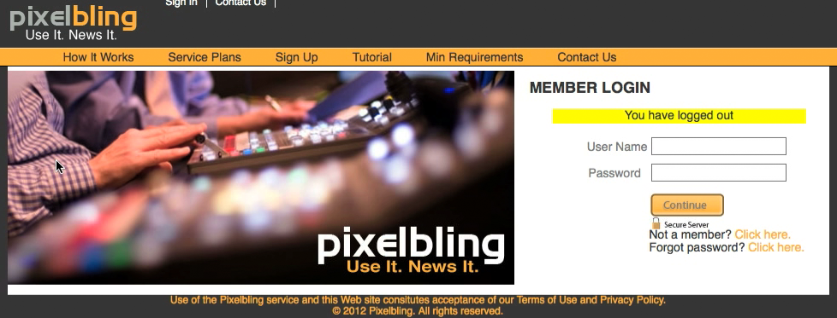
pixelbling User Guide
Create Account
Next, you will be directed to select a Service Plan.
Read through our different options and choose the plan that best suits your needs. Once you have chosen, you will need to complete your order by clicking on the Register button. Upon choosing a Service Plan, you will need to fill out all the necessary billing information. Or, you can click on Free Trial to try out our Advanced Package for 30 days, free of charge.
Now that you are registered, you can sign in with the username and password you created. Click the Continue button; you’re almost finished with setup

Slide 8
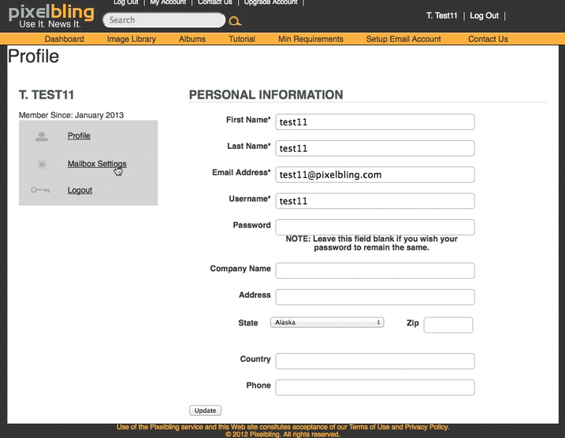
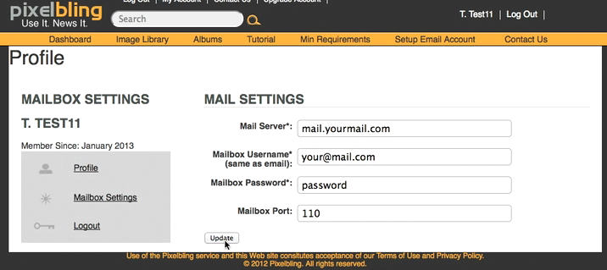
pixelbling User Guide
Mailbox Settings
In order to receive your viewer pictures, Pixelbling will need the mailbox information to connect to the designated email address. If you don’t know this information, you can get it from your Technical Administrator who handles all of your email accounts.
Here is an example of what it might look like.
Mail Server: Your mail server
Mailbox Username: This is the email address that viewers are sending photos to.
Email Mailbox Password: This is the password used to access the email address.
Mailbox Port: Usually port 110 works, but your Technical Administrator will know for sure.
Then, click Update to save your settings.

Slide 9
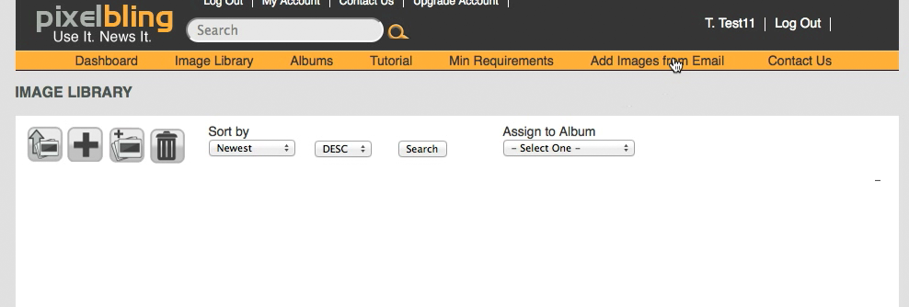
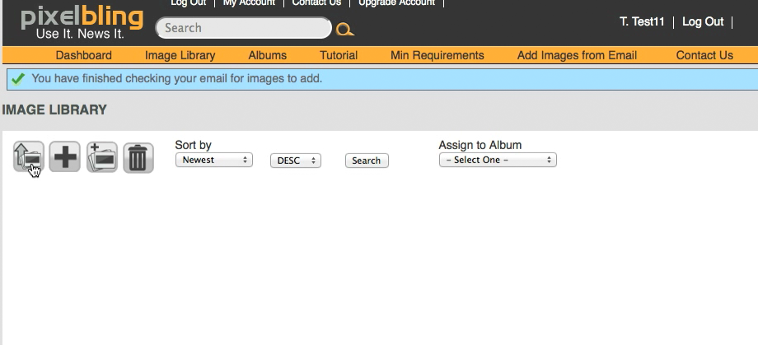
pixelbling User Guide
Image Library Upload
If your mailbox is connected to Pixelbling already, then simply click “Add Images from Email” and viewer photos will start populating in the Image Library as they are sent.
If you haven’t entered your mailbox settings yet, or if you haven’t received any viewer photos yet, that’s ok, because you can also upload images directly from your computer’s desktop. To upload images from your desktop, click the Upload Image icon. Browse your files using this upload window, select the photos you want to upload, and click Upload.

Slide 10
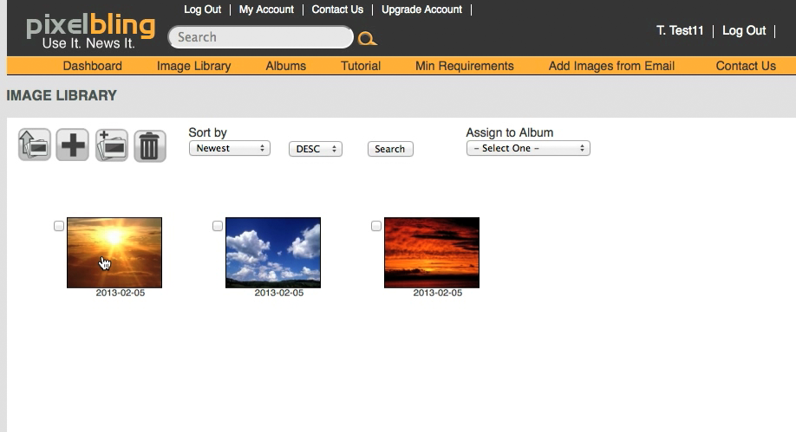
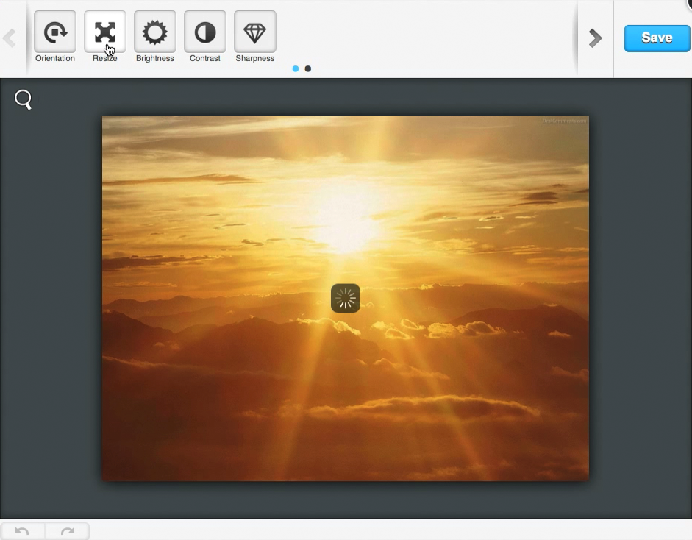
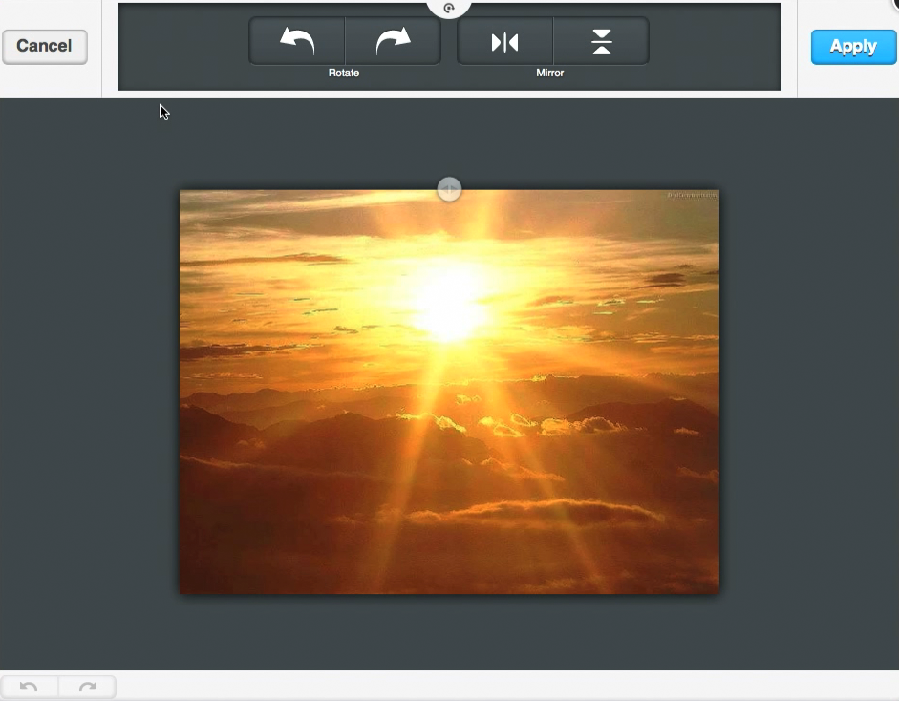
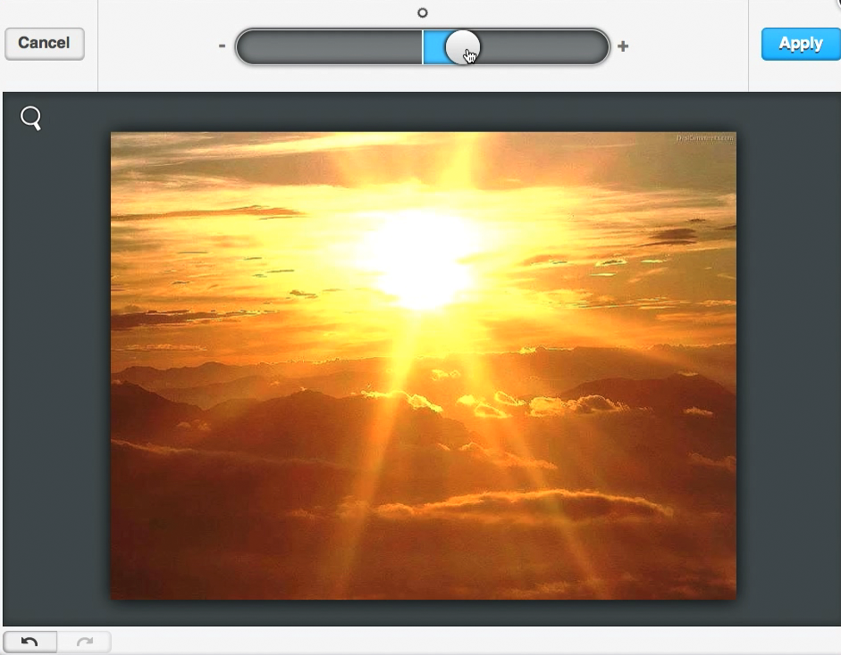
pixelbling User Guide
Image Editor
To edit an image, click on any image and the Image Editor will open
In the image editor, you will be able to Rotate, Scale, Brighten, Contras and Sharpen. Once an Image is in edit mode click the icon for what you want to do an adjust the image using the slider. Once you are happy with the results, click Save. Then simply close the editor to return to the Image Library.

Slide 11
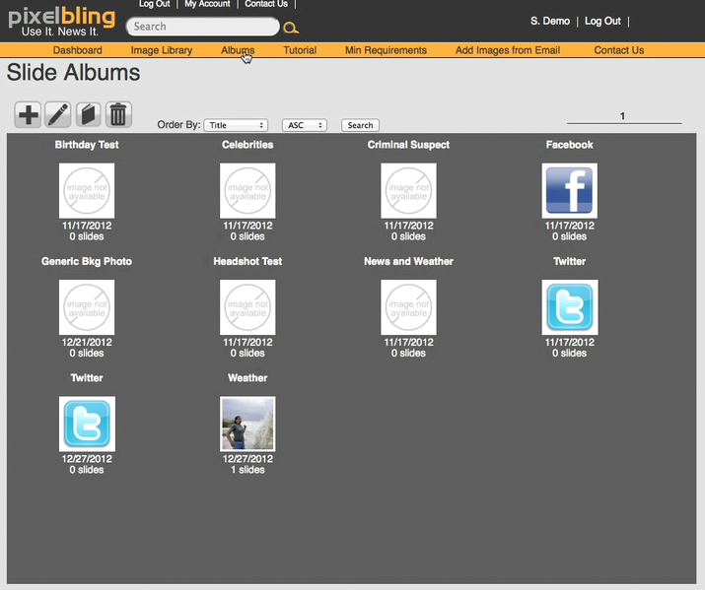
pixelbling User Guide
Album
To build an album using images from your Image Library, start by clicking on “Albums”. Depending on the Service Plan you chose, you will already have 3 to 7 preloaded Albums with themed templates and transitions to start with.

Slide 12
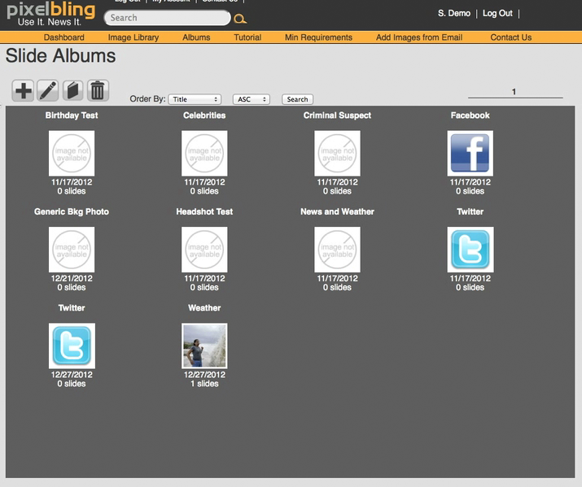
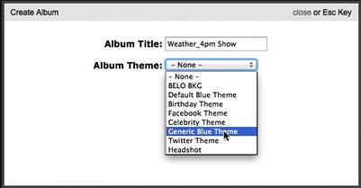
pixelbling User Guide
Album
Click the Create Album icon. A menu will prompt you to title your Album and select a Template Theme.
It’s a good idea to name it according to the theme used and the show it’s for. Most users find that it’s easiest to create an album for each show and use it every day, replacing the images for each new show. But it’s up to you; you can have as many albums as you want. To help keep your albums organized, you can sort your albums by name or by the dates they were created.

Slide 13
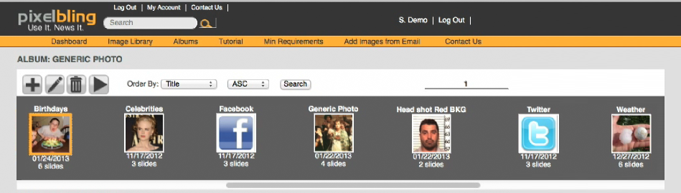
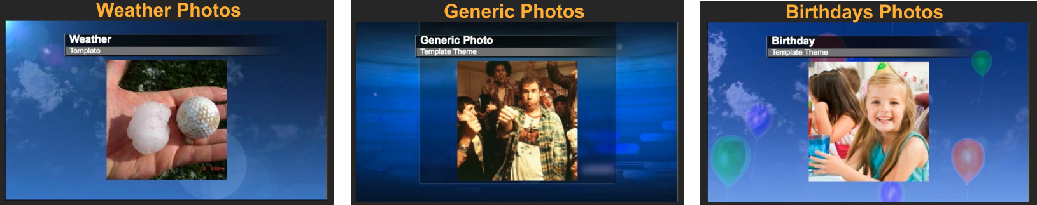
pixelbling User Guide
Themed Templates
Themed Templates are made to showcase a specific subject matter like Weather, Head shots, Birthdays, Facebook, Twitter, and so on. They help the viewers to understand what they are looking at. Depending on the Service Plan you chose, you will already have 3 to 7 preloaded Albums with themed templates and transitions to start with.
The Standard Plan: Has these 3 Templates: Weather Background with Photo and text, Generic Background with Photo and text, and Birthday Background with Photo and text. The 3 dynamic transitions are 3D Cube, Slide and 3D Blinds.

Slide 14
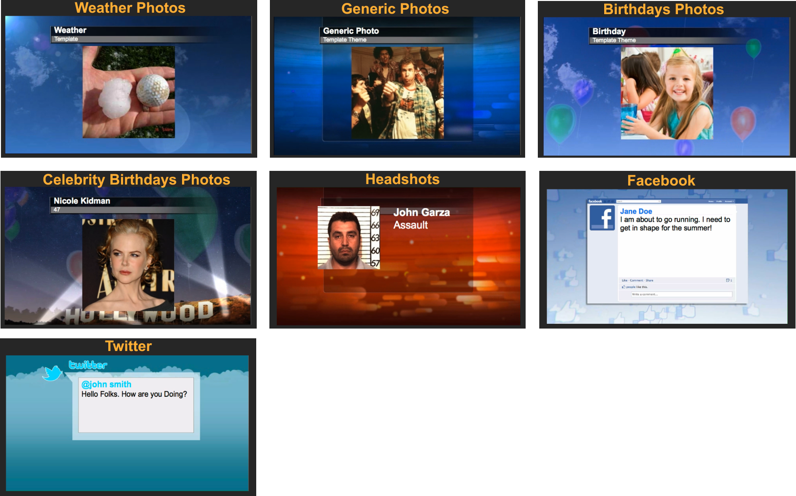
pixelbling User Guide
Themed Templates
The Advanced Plan: Has these 7 Templates: Weather Background with Photo and text, Generic Background with Photo and text , Birthday Background with Photo and text, Celebrity Birthday Background with Photo and text, Headshot Background with Photo and Text, Facebook Background with Text Only, and Twitter Background with Text Only. The 6 dynamic transitions are 3D Cube, Slide ,Page Turn, 3DBars, Concentric, and 3D Blinds.
Pixelbling can customize a themed template with background animation or still image that reflects the style guide of your news station or business. You can send us the backgrounds, or our designers can make one for you. Just send us your request at info@pixelbling.com , support@pixelbling.com or use the Submit Request page.

Slide 15
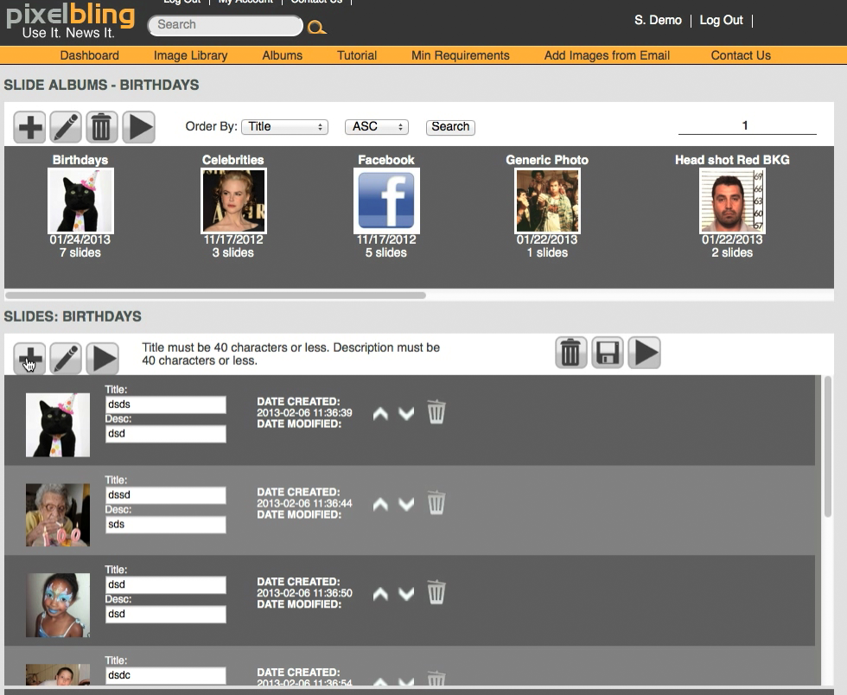
pixelbling User Guide
Add Images to Album
To add images to your album, you can either select your album from the Dashboard and click the Add Image icon to get to the Image Library, or you can click on Image Library at the top of the page.

Slide 16
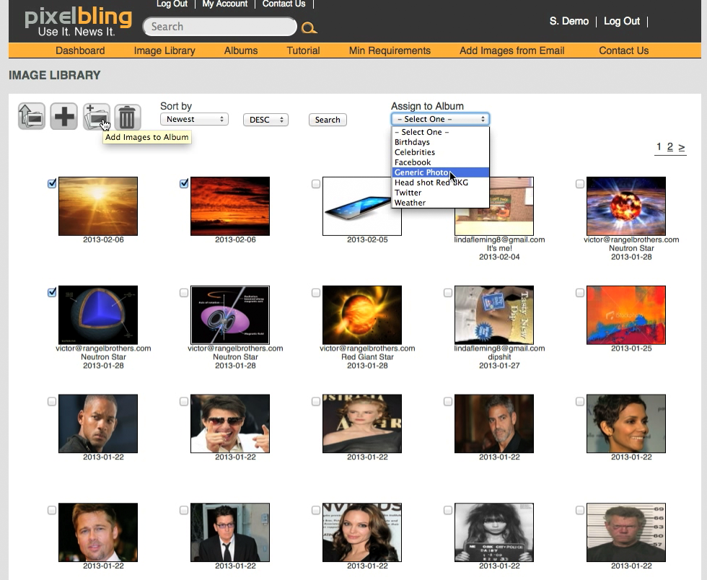
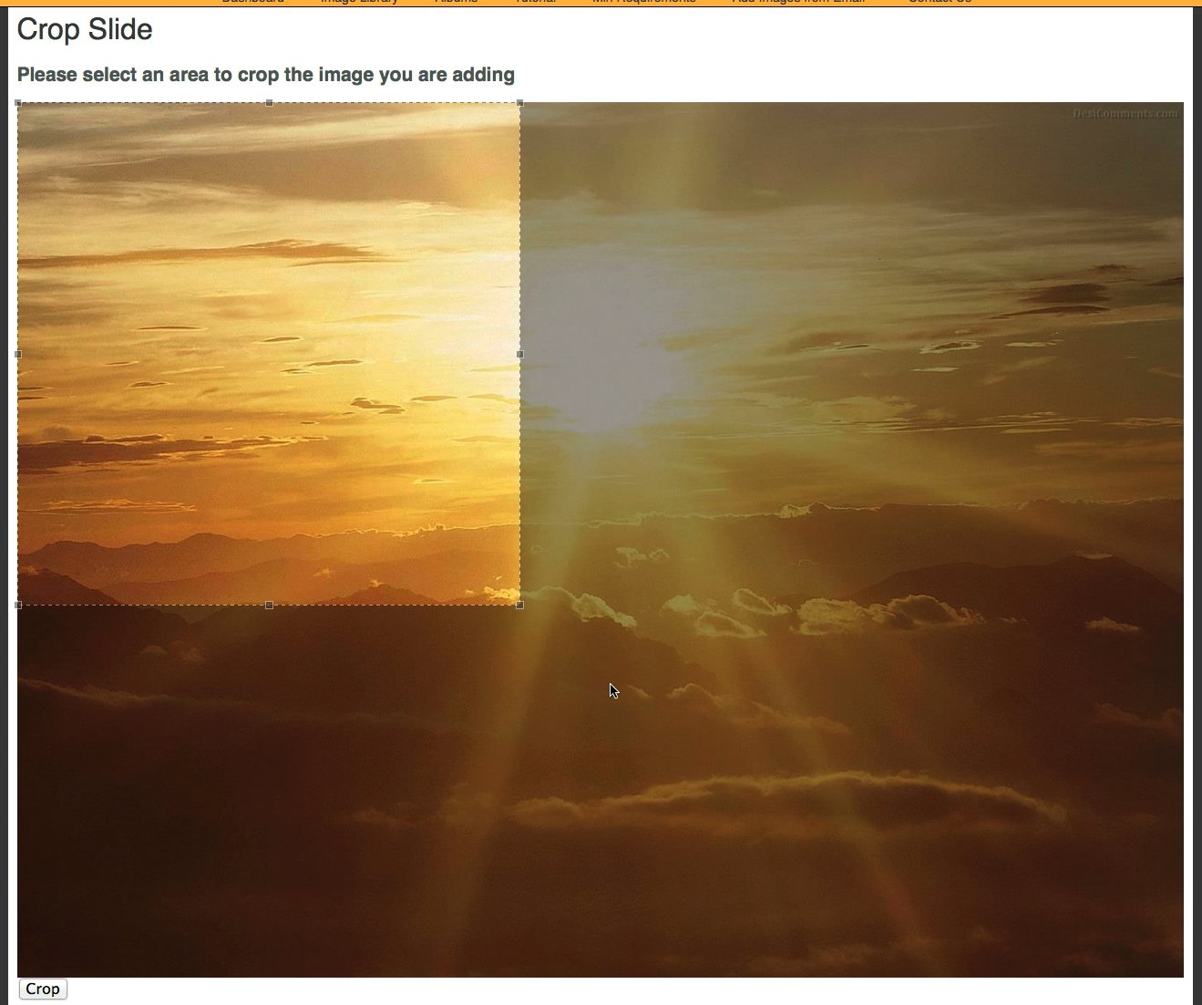
pixelbling User Guide
Add Images to Album
In the Image Library, select a handful of images. Select the Album you created from the drop down menu. As you create more albums you will see them in the drop down. Then click the “Add images to Album” icon.
You will then be sent to a “Crop Slide Page” where you will need to crop each image so that the images will work with the dynamic transitions. You can scale the crop region proportionately. Once you’re happy with your selection, click Crop and go onto the next image. You will ALWAYS be prompted to crop each image upon adding it to an album, so that it will be compatible with the dynamic transitions.

Slide 17
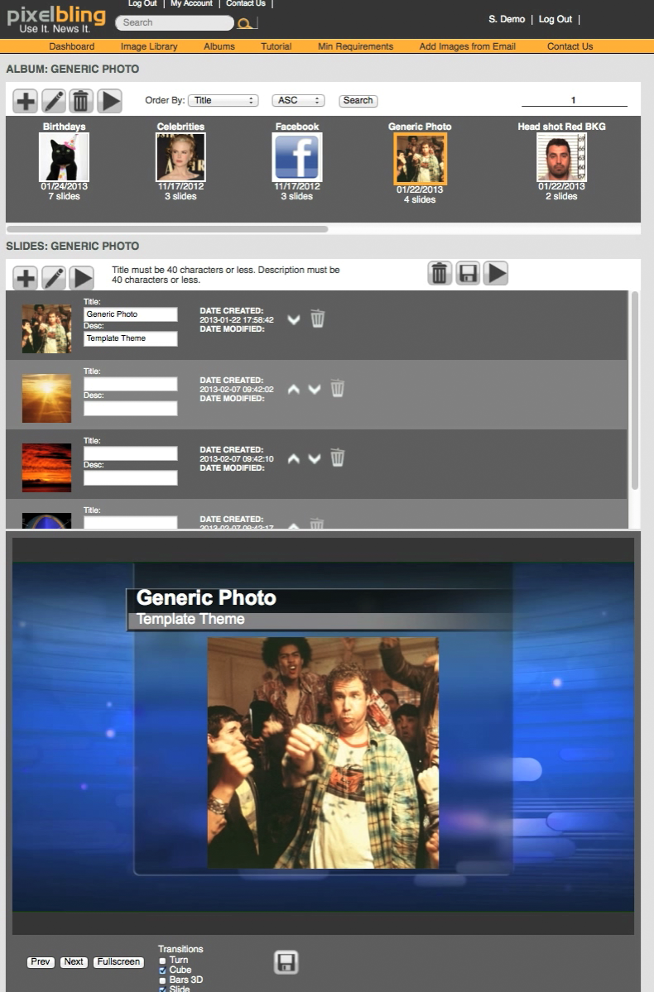
pixelbling User Guide
Dashboard
The Dashboard is where you keep track of your albums, edit the slides within them, preview them with the transitions, and play them in Fullscreen Mode for On-Air broadcast. To get to the dashboard from any other page, click Dashboard. The Dashboard is made of three sections: Albums, Slides, and Preview.
Albums
Slides
Preview

Slide 18
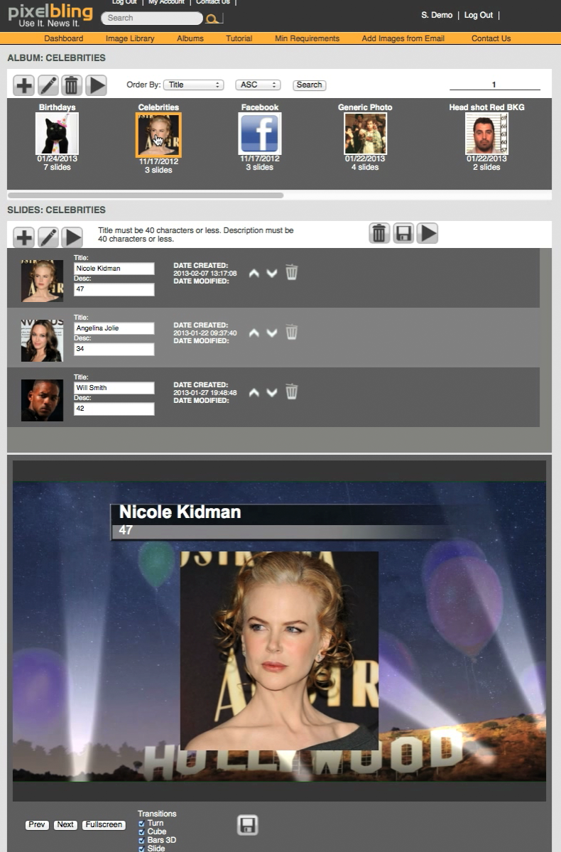

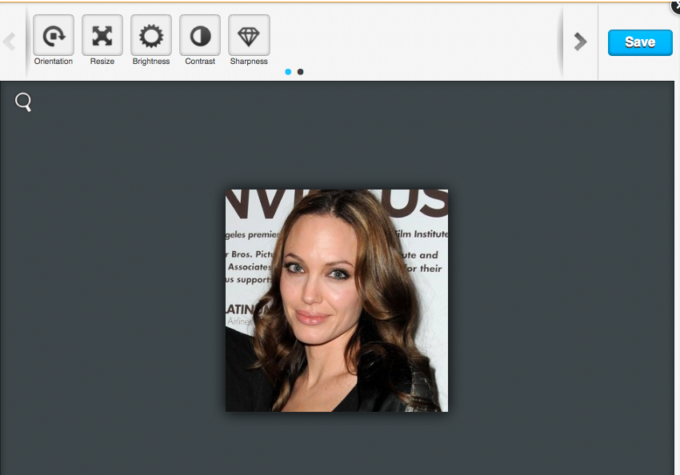
pixelbling User Guide
Dashboard
To edit the slides in an Album, look in the Albums section and select the album you want to work on. Once you select an Album, you will notice all the display in the Slides section and Preview section.
You can enter a title and description for each slide with the two text fields. Be sure to click the
save icon.
If you want to edit an image, click the image to open the Image Editor. When you are finished editing your slides, be sure to click the blue save icon, or your edits will be lost.

Slide 19
pixelbling User Guide
Dashboard
Albums
Slides
Below the Slides section is the Preview section. This is where you can preview your Albums you build and edit. You can select different transitions to play between your slides. Once you have selected the transitions you want, make sure to hit the Save button.
The Previous and Next buttons will advance the slides. When all your slides are prepped and ready to broadcast, simply hit the Fullscreen button.
Preview

Slide 20

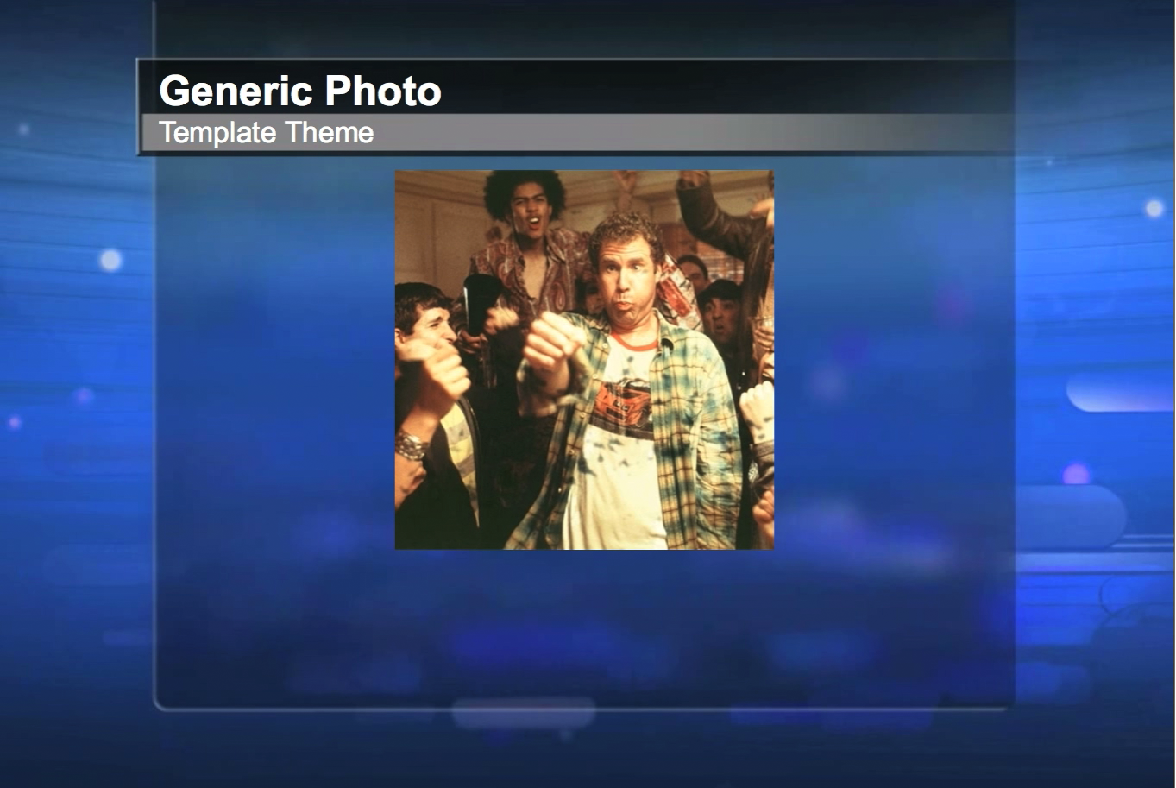
pixelbling User Guide
Dashboard / Fullscreen Mode
Once you are in Fullscreen mode, you simply hit the arrow keys on your keyboard to advance the slides. When you are finished, you can hit the Escape key twice on your keyboard to return to the Dashboard.

Slide 21
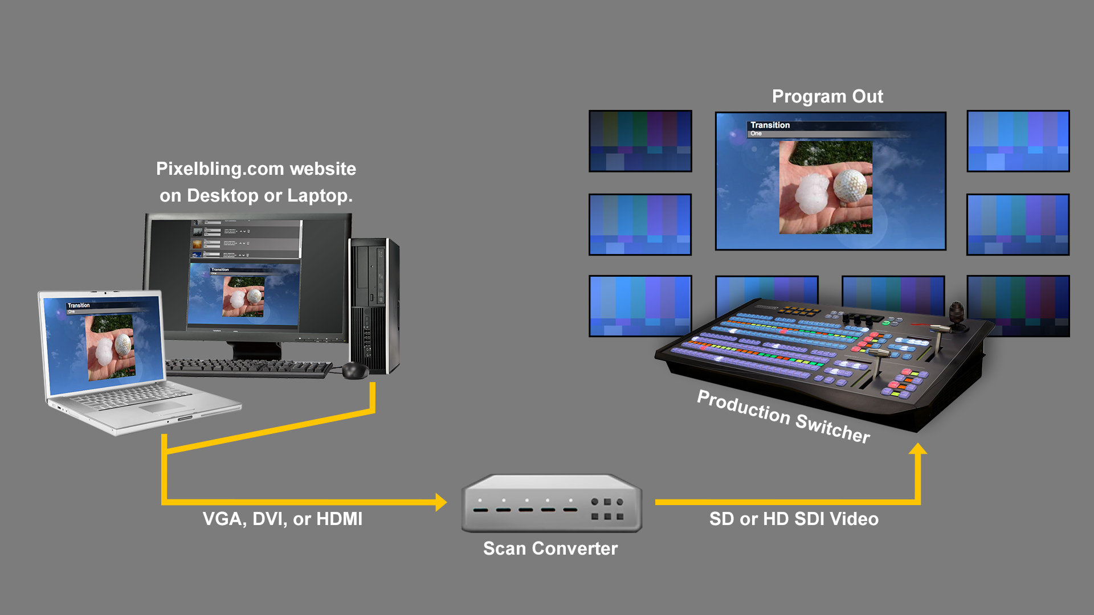
pixelbling User Guide
Technical / Scan Converter
Most control rooms are already equipped to take a website as a video source. However if your control room is not, this schematic shows how it should be connected. The PC is connected to a scan converter, the scan converter is connected to a production switcher.

Slide 22
pixelbling User Guide
More Information
  If you have other questions concerning technical issues or the service plans, please send us a Email us at support@pixelbling.com or info@pixelbling.com And we will get back to you shortly. Thank you for choosing Pixelbling.

